Slide 1
EECS-343 Operating Systems Lecture 3: Process Creation and Memory Layout
Steve Tarzia
Spring 2019

Slide 2
Announcements
Project 1 due on Monday!

Slide 3
Last Lecture
Process is a program in execution
Limited direct execution is a strategy whereby a process usually operates as if it has full use of the CPU & memory.
CPUs have user and kernel modes to prevent user processes from running privileged instructions, thus limiting execution.
Interrupts are events that cause the kernel to run
System Calls (or traps) are software interrupts called by a user program to ask the OS to do something on its behalf.
Timer Interrupt ensures that the kernel eventually runs.

Slide 4
Readings
So far, we’ve covered Chapters 1-4 and 6 (Chapter 5 is today).
Please read the Scheduling chapters next (Chapters 7-9)
In the future, just try to follow along on your own.
The syllabus says which chapters we’re skipping.

Slide 5
Example Unix syscalls (process-related)
exit – terminate the current process
fork – duplicate the current process
wait – wait for a process to terminate
exec – run a program (in the current process)
time/stime – get/set current time (in seconds)
brk – change the process “break,” meaning max memory address
getpid – get current process’s id
pause – wait for a signal from another process
kill – send a signal to another process (named after one signal type)
getuid/setuid – get/set the effective user id of the current process

Slide 6
Example Unix syscalls (file-related)
read/write – read/write data from a file descriptor
open – open/create a file
close – close a file descriptor
chdir – change working directory
mknod – create a filesystem folder
chmod – change permissions of a file
chown – change ownership of a file
seek – change r/w offset in a file
utime – change modification time of a file/folder
mount/umount – mount or unmount a filesystem

Slide 7
“Hello world” with syscalls (in Linux)
C code:
int main() { write(1, “Hello, world\n”, 13); exit(0); }
Notice that we are not using printf
printf is a libc function
libc’s implementation of printf will use write, which is a syscall.
(Bryant and O’Hallaron, Figure 8.11) →

Slide 8
Last time: Arrows on this slide were wrong
Stored on the top of the process’ stack
Memory is “virtual.” We’ll see later that it’s very easy to switch.

Slide 9
xv6 stores register values are stored in three places
In struct context (proc->context): ebx, esi, edi, ebp, eip and esp is the address of the struct.
In the user process’ stack: eax, ecx, edx (by the x86 calling convention)
In struct trapframe (proc->tf): esp, and also copies of edi, esi, ebp, eax, ebx, ecx, edx
These are automatically written by the CPU hardware when an interrupt occurs.
Why store duplicates? …idk
2
1
2
2
1
1
1
3
1

Slide 10
proc.h
Pushed on “top”
When kernel takes over during the interrupt handler, it copies register values from the trap frame to a new struct context that’s pushed on the user process’ stack.

Slide 11
…and in x86.h:

Slide 12
The OS Coder’s Curse
Not only do we have to use C…
We also have to understand the Intel x86 processor architecture
x86 is messy because it carries
40 years of incremental updates and backward compatibility
but it’s the architecture most relevant to SW Eng. practice
We’ll gloss over some of the low-level details
Read the xv6 book & code when you really need to know.
Photo from http://www.righto.com/2013/09/intel-x86-documentation-has-more-pages.html

Slide 13
Interrupt handling involves both hardware and software
In response to interrupt, the CPU hardware:
Saves main registers to trap frame on the kernel stack (each process has two stacks)
Switches to kernel mode
Jumps to interrupt handler code
Then kernel software takes over to handle the interrupt and when finished can switch to a different process if desired.

Slide 14
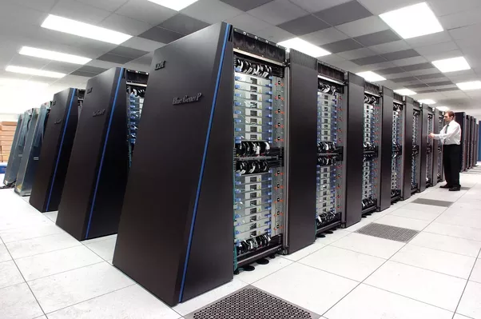
Instruction set architectures vary
Low-level OS code for Intel x86 looks very different than that for ARM, PowerPC, SPARC, etc.
Linux supports all of the above architectures and it requires different assembly code to handle context switches and interrupts on each.
So, let’s try not to get hung up on the machine-dependent details.

Slide 15
An OS can support multiple CPU architectures
Linux supports x86 plus 30 other architectures, and growing!
See https://github.com/torvalds/linux/tree/master/arch
How? Different low-level code is used for different builds.
Includes some C and Assembly code
This is just a small fraction of the overall Linux codebase
But it would probably be close to half of xv6, since it’s such a simple OS.
“Ports” of the Linux OS tend to be managed by different groups
Eg., much of the ARM source code bears the following comment:
Copyright (C) 2012 ARM Ltd. Authors: Will Deacon <will.deacon@arm.com> Catalin Marinas <catalin.marinas@arm.com>

Slide 16
Writing an OS for multiple CPU architectures
What’s different?
All the assembly code + some C
Boot code
Mechanisms for
Interrupt handling
Context switching
Memory management
Device drivers (to control peripheral hardware)
Etc.
What’s the same? … most C code:
Filesystems
Process scheduler
Inter-process communication
Networking
Security / user management
Policies for
Context switching
Memory management

Slide 17
Linux’s entry.S in both x86 and arm for context switch

Slide 18
Context switch x86 assembly code
Linux
xv6
Difference #1: xv6 passes parameters on stack
Difference #2: %esi & %edi registers are in different order

Slide 19
Process creation in Unix
Uses a combination of fork and exec syscalls
Fork creates an exact duplicate of the current process, except
Has a new process id
Parent/child processes are different
Return code of fork() command is different (…you’ll see what I mean)
Exec overwrites the code of the current process with that in a file
It looks like a strange design, but it makes the command-line shell implementation clean.

Slide 20
Fork syscall
The new (child) process continues where the parent left off.
It does not start from the beginning of main()
fork returns:
0 to the child process
the child pid to the parent
Two processes share the same stdin, stdout, & stderr
Output:
hello world (pid:29146)
hello, I am parent of 29147 (pid:29146)
hello, I am child (pid:29147)

Slide 21
Nondeterminism
At the end of the fork syscall, the OS has two runnable processes.
We cannot predict whether the OS will schedule the parent or child process to run next.
Depends on the runtime situation and hidden kernel implementation details.
Thus the program’s output’s called nondeterministic or indeterminate.
Meaning it can exhibit different behavior on different runs.
There are two output possibilities:
Output possibility 1:
hello world (pid:29146)
hello, I am parent of 29147 (pid:29146)
hello, I am child (pid:29147)
Output possibility 2:
hello world (pid:29146)
hello, I am child (pid:29147)
hello, I am parent of 29147 (pid:29146)

Slide 22
Nondeterminism
Can arise when a concurrent program has a race condition, meaning:
Two or more things are happening at the same time,
It’s not clear which will finish first, and
The output will be different depending on which finishes first.
In the fork example, the two competing tasks were:
The parent process waiting to run and print
The child process waiting to run and print
Race conditions can lead to difficult software bugs
99% of the time it behaves one way, but sometimes it behaves another way
Heisenbugs – bugs that disappear when testing (in this case due to timing)

Slide 23
Can you spot the tricky bug here?
This code is nondeterministic
Either parent or child will print first character of file
However, this code will also crash in very rare scenarios.

Slide 24
A race condition between child’s read and parent’s close
The child’s read can happen after the file was closed by the parent.
Normally, close will happen well after both reads, because do_some_work will be slow.
But this is not guaranteed!

Slide 25
Recall that CPU exceptions are a type of interrupt
Often caused by arithmetic errors (divide by zero), and memory violations (eg., dereferencing a null or invalid pointer)
When user code causes an exception:
Kernel interrupt handler runs, and will likely kill the user process.
What happens when kernel code causes an exception?
Interrupt handler will still run, but it’s not clear what can be done in response.
On Windows, the famous “blue screen of death”
On Linux, a “kernel panic”
This is commonly seen by kernel developers, but hopefully not users.
This is different than the machine just freezing.
Kernel knows there is a problem, but doesn’t know how to react.

Slide 26
On Windows (old & new)

Slide 27
On older Macs

Slide 28
On Linux

Slide 29
Intermission recap
xv6 OS code is written for the Intel x86 CPU architecture, but…
Linux supports 31 different CPU architectures
Low-level mechanisms are different on each arch.
High-level policies are the same for all.
Fork syscall: run once, exits twice!
Nondeterminism is when a program’s output is unpredictable
OS process scheduler can create race conditions in programs that rely on an interaction of multiple processes.
These are tricky to debug, because they are sensitive to timing (Heisenbugs).
Kernel panic occurs when OS causes an exception and can’t recover

Slide 30
Starting a process
Requires just a few steps:
Copy machine code and initial data into memory
In other words, copy the program’s executable file into memory
Set instruction pointer register to address of code start
In other words, jump to code start
Code will use the registers and memory as necessary to perform it’s work.

Slide 31
What’s this stack we always talk about?
a.k.a: execution stack, machine stack, call stack, control stack
It’s just a convenience for the assembly programmer/compiler.
Allows program to call subroutines and manage local variables with just a few instructions.
Stack pointer (%esp) is used & automatically adjusted by:
push, pop
call, ret (return)
addresses

Slide 32
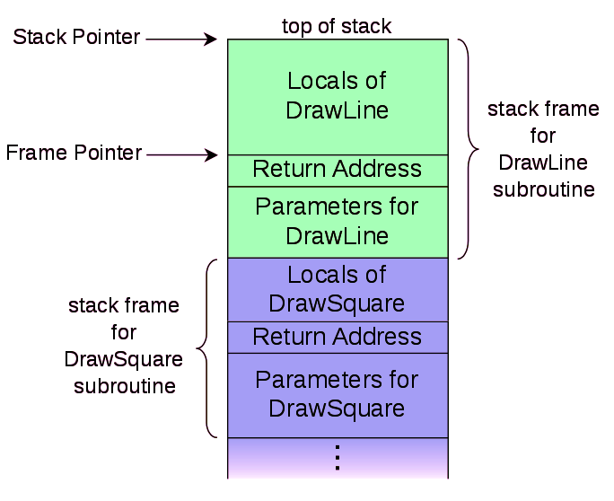
Using the stack for subroutines
Greatly simplifies machine code generation for C-style functions
Current function’s local variables are on top of the stack
To return,
restore caller’s stack frame by restoring %esp, %ebp
Place function’s return value in %eax
DrawLine code can always find it’s parameters and local variables
Regardless of when/where the function was called, variables can be found relative to %ebp, the frame pointer
In other words, the stack allows subroutines to be mutually isolated.
%esp
%ebp
addresses

Slide 33
Heap memory
Heap is just where C’s malloc function dynamically allocates memory.
The CPU has no notion of a special heap region.
Organizing memory into stack and heap is just a convention.
Stack and Heap grow toward each other, eating free space between.
“Heap” memory has nothing to do with the “heap” self-balancing priority queue data structure.

Slide 34
Context Switch to change process
Context switch is when CPU switches from running one process to running another.
Want context switches to be fast, to give user the illusion that processes are running simultaneously
Need to swap out all process state
Registers are small & fast, so they can be saved and restored
But how to deal with memory?
It’s big!
Would be too slow to copy all memory elsewhere (to disk?)
Code
&
Data

Slide 35
Linux process virtual memory address regions
Top of the memory range is reserved for the kernel.
This is actually mapped to the same physical memory for every process.
On the PC, low memory range is reserved for I/O
Shared libraries are not used in xv6, but they exist in modern OSes like Linux

Slide 36
Operating systems vary in the details
Linux process memory layout
xv6 process memory layout
0xC0000000
Issues with xv6 layout?

Slide 37
Final recap
fork + exec runs a program.
fork duplicates the current process
exec copies code and global data from an executable file, and creates a new empty stack.
Stack grows from high addresses down to lower.
Grows larger when a function is called.
Shrinks when a function returns.
Heap is a block of memory managed by C’s malloc & free.

