Slide 1
EECS-343 Operating Systems Lecture 1: Introduction
Steve Tarzia
Spring 2019

Slide 2
Today’s lecture
What will you learn from this class?
How will this course be operated?
Are you ready to take this class?
What is an Operating System?
History of computers and their operating systems

Slide 3
Why study OS?
You will probably never write a new OS (please don’t!)
But you may need to modify an OS or write device drivers for new hardware.
More importantly, to understand application software performance, you must understand what the OS is doing behind the scenes.
You’ll also get some good software engineering experience.
This is likely the first class where you’ll have to modify a large, complex, existing codebase.
Get practice with C, Linux, and tools like git, gcc, gdb, make, etc.)

Slide 4
Important Topics
Security
How processes (apps) are isolated from each other when running together.
Eg., how the recent Spectre and Meltdown attacks work
Performance
How virtual memory & paging affects read/write latency
How processes compete for shared resources
Concurrency
Synchronization (how processes coordinate using locks, semaphores)
Non-determinism (how race conditions can lead to weird bugs)

Slide 5
Course logistics
We’ll use Canvas for assignments, announcements, lecture slides.
I will try to post videos of all lectures
Staff:
Steve Tarzia, instructor
Teaching Assistants:
Yingyi Luo
Xutong Chen
Kaiyu Hou
TA & PM office hours in Mudd 3303:
Mondays 1-7pm, Wednesdays 1-4pm
Ask all questions on Piazza (not by email)
Final exam is Monday June 10th at 3pm. Midterm date TBA soon.
Peer Mentors:
Richie Lee
Michael Hsu
Peter Bi
Rohit Rastogi
Ziqin Xu
Tianhao Zhang

Slide 6
Prerequisites
Data Structures (EECS-214)
Basic C/Unix programming (EECS-213)
Basic assembly coding (EECS 213 or EECS-205)
If you’re unsure, then start the first project ASAP
If you’re going to drop, better to drop sooner than later

Slide 7
Collaboration & cheating policy
Helping each other is OK, but you should not do anything that allows another student skip the learning process.
You may talk to other students about the homework and projects
You may look at small parts of each other’s code (on the screen)
You may not send a copy of your code to friends
You may not post your code to a public git repository.
If you copy code from the Internet, you must add a comment explaining the source.
You must understand what your code does
I will use MOSS to compare your code to everyone else’s code and prior years’ code.
If you spent fewer than 6 hours on a project, then you probably cheated!
I will notify the Dean of blatant cheating and you may be expelled from Northwestern.
If you’re unsure about this policy, please ask me.

Slide 8
Grading
50% -- 4 Projects
C kernel development.
The most difficult part of the course!
10% -- 4 Homework assignments
Short written answers, based on reading & lectures
15% -- Midterm exam
25% -- Final exam (cumulative)
Exams are similar to homework assignments

Slide 9
C language is good for building Operating Systems
C can interact with hardware directly
C code can include some assembly code, when necessary.
Assembly code gives access to instructions for low-level stuff like:
interrupts, CPU registers, changing CPU modes.
C gives direct access to memory to create interrupt tables, etc.
A C pointer is a number specifying a location in memory.
C compiles directly to machine code
It does not require any runtime translators and libraries
Behavior is reasonably predictable (no weird garbage collection processes)
Can inspect the resulting machine code to tweak performance
C is very efficient

Slide 10
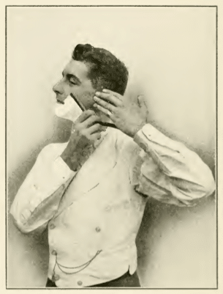
C was wonderful in the 1970s and 80s, but…
40 years later, it feels inconvenient and dangerous.
Like shaving with a straight razor.
Lacks standard dynamic collections (lists, dictionaries)
Must manage memory yourself (malloc & free)
Cannot easily write generic code
Pretty strongly typed, and no inheritance
Cannot throw/catch exceptions
Must check function return status explicitly
Function parameters often contain return values
Have to pass pointer to pre-allocated buffer as a parameter, and choose buffer size
No good, free IDE. You will use something like emacs, vim, or gedit + make + gdb
C
Python

Slide 11
Lab hours & Office hours
TAs and Peer Mentors will hold office hours in Mudd 3303 (to help you with the projects)
Mondays 1-7pm
Wednesday 1-4pm
Steve’s office hours in Mudd 3225:
Mon 1-3pm, Tues 3:30-4:30pm, Wed 3-5pm, Thurs 3:30-4:30pm

Slide 12
Required reading
666 page, “open” textbook
Chapter PDFs are online
$10 for one big PDF
$22 softcover
$38 hardcover
Entertaining read
Repeats & reinforces lectures
For homework and exams
Buy a hard copy because exams are open book!

Slide 13
About Steve
Second year teaching at Northwestern.
PhD from Northwestern in 2011, BS from Columbia in 2005, both in Computer Engineering
Research expertise is acoustic sensing on mobile systems.
Worked at a few Chicago area software startups First as a software engineer, later as VP of Engineering
Have published about ten iOS apps in the app store
Fan of Linux, AWS, Java, Python, Objective-C
Founded the National Gun Violence Memorial (GunMemorial.org).
Enjoy competitive lap swimming, cooking, repairing things, opera, and playing music (guitar, drums, trumpet).
Married 14 years & have lived in Evanston for the past 8 years.

Slide 14
Operating Systems
From the past:
IBM OS/360, AT&T Unix, DOS, MacOS “classic”, Windows 3.1, 95, XP, 2000
And in the present:
Windows 7, 8, 10
MacOS X
Linux
BSD
Android
iOS

Slide 15
Unix family tree

Slide 16
xv6
A small teaching Operating System, used for the course projects
Less than 80,000 lines of code
Instead of about ~15 million for Linux
Very limited functionality
It does really run on very basic PC-compatible hardware
We’ll be running it on an emulated machine (Qemu)
Xv6 lacks drivers for most real hardware accessories/peripherals (can’t use network cards, most storage devices, graphics)

Slide 17
How is an OS different than a software application?
Pair and share

Slide 18
Roles of an OS
A user interface for humans to run programs
A resource manager allowing multiple programs to share one set of hardware.
A programming interface (API) for programs to access the hardware and other services.

Slide 19
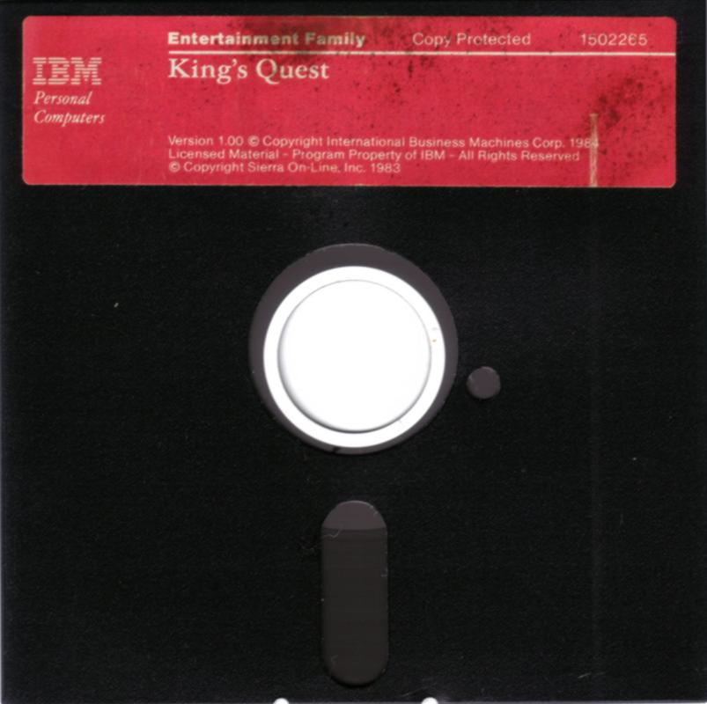
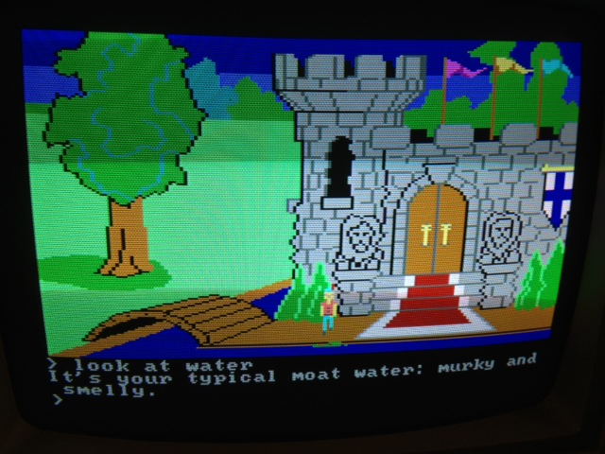
Before operating systems
User could only run one program at a time.
Had to insert the program disk before booting the machine.
Program had to control the hardware directly
This is a nuisance because hardware is complicated
Program will only be compatible with one set of hardware
For example (at right) 1983 “King’s Quest” game for IBM PC Jr.

Slide 20
OS sits between hardware and your apps
User processes
iTunes
Powerpoint
Thunderbird
Chrome
Qemu
Application Interface
File System
Virtual Memory
Process Manager
Network
Operating System
Device Drivers
Interrupt Handlers
Boot and Init
Hardware Abstraction Layer
Hardware

Slide 21
What’s part of the OS? – hard to define!
Kernel – the only code without security restrictions
OS distribution – the kernel + lots of other useful stuff
Process scheduling (who uses CPU)
Memory allocation (who uses RAM)
Accesses hardware devices
Outputs graphics
Reads/writes to network
Read/write to disks
Handles boot-up and power-down
GUI / Window manager
Command shell
Software package manager
“app store”, yum, apt, brew
Common software libraries
Useful apps:
Text editor, compilers, web browser, web server, SSH, anti-virus, file-sharing, media libraries,

Slide 22
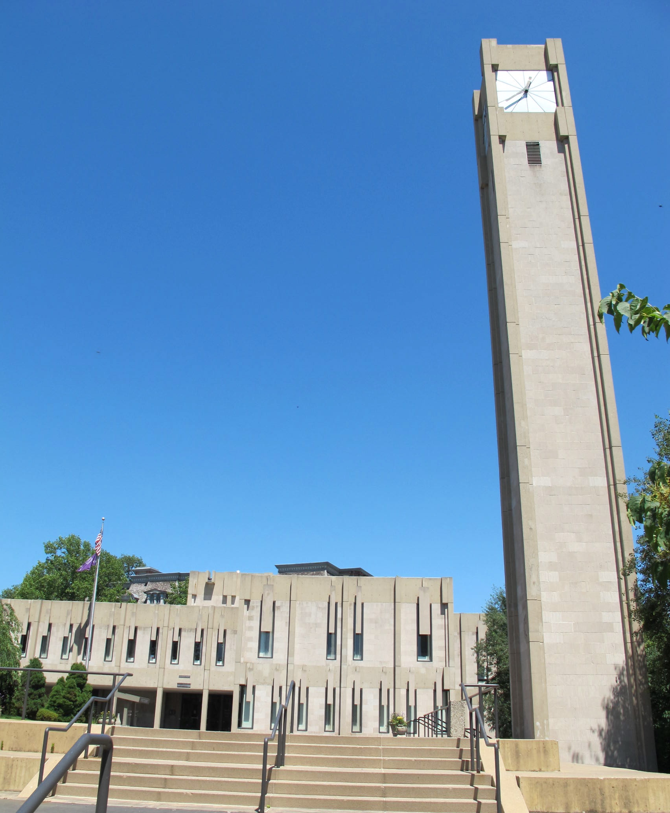
In the academic world,
Ivory tower
when we say “OS,” we usually mean just the OS kernel.

Slide 23
Operating systems have evolved with hardware
Sophisticated operating systems first arose on mainframes.
OS ideas migrated to smaller machines as those machines became more powerful.
In 2019, a smart watch has 1gb RAM, 16gb SSD storage, two CPU cores, and a real OS.

Slide 24
Early evolution of computing systems
1955: Batch systems
Collect a bunch of program punch cards and write them all one matgetic tape.
Run the tape through the mainframe to execute all the jobs in sequence.
1960s: Multiprogramming (IBM OS/360)
Keep multiple runnable jobs in memory at once.
Allows overlap I/O of one job with computing of another.
Uses asynchronous I/O and interrupts or polling to detect I/O completion
1960s: Timesharing (MULTICS, Unix)
Multiple user terminals connected to one machine
Allows interactive use of machine to be efficient (because another user’s job can run while you’re thinking).

Slide 25
Later evolution of computer systems
1970s: Parallel systems
Processes must communicate to share information.
Synchronization is difficult.
1980s-90s: Personal Computers (IBM PC, Macintosh)
Graphical user interfaces were developed
Mainframe OS concepts (like networking) were applied to PCs
Magnetic disks become huge, but still slow
2000s-10s: Mobile and pervasive computing, Cloud Computing
Slow hardware is once again common (phones & wearables)
OS manages sensitive information like location and Internet behavior
Fast flash storage is common.
Server hardware is shared by many different cloud computing customers

Slide 26
Recap: OS is a resource manager
A computer has many apps (processes) running
All need access to:
CPU (processor)
RAM (memory)
Storage (disk/filesystem)
Other hardware like Network card, display, sound card.
OS provides safe, fair sharing of the limited hardware resources.

Slide 27
Your first tasks
Buy the book
Find a project partner
Start Project 1 – as soon as possible!
Project 1 parts 0 and 1 are due on Monday!
Email root@eecs.northwestern.edu if you have trouble with lab machines
Part 2 (the difficult part) will be posted soon (tomorrow).
After that:
Start reading chapters 1-6
Watch old timesharing video (1963, Corbató @ MIT): https://www.youtube.com/watch?v=Q07PhW5sCEk

