Slide 1
CS-340 Introduction to Computer Networking Lecture 18: QUIC and Course Review
Steve Tarzia

Slide 2
Last Lecture: Mobility
IP addressing was designed for a static world.
Mobile IP gives host a permanent home address.
Registers with Foreign Agent which registers with Home Agent.
Home agent encapsulates received traffic in IP tunnel, forwards traffic to foreign agent at care-of address.
Smartphone push notifications also use location registration.
Handoff: set up the 2nd channel, transfer connection, then close 1st.

Slide 3
Let’s Review some Networking Themes.

Slide 4
Decentralization
There is very little centrally-controlled infrastructure for the Internet.
ICANN just controls the distribution of IP address and domain names.
Internet standards are developed by the IETF through an open process, leading to RFCs.
Internet’s physical links added ad-hoc by pairs of AS’s choosing to peer.
DNS: 13 root server IP addresses, then top level domains (TLDs).
DNS servers at the edge of the network cache results.
BGP uses Distance-Vector algorithm to compute shortest path.
TCP congestion control mitigates core congestion from observations at the edge.

Slide 5
Fault tolerance
Assume that links and routers are unreliable:
Bits can be flipped, • Packets can be dropped
This software/protocol-level assumption simplifies hardware design
Bit error checking is included in Ethernet, IPv4, TCP/UDP headers.
BGP allows routes to change in response to broken links.
TCP provides delivery confirmation, retransmission, and ordering.
TLS provides message integrity (with digital signatures).
HTTP response code can indicate an error
(eg., 404 Not Found, 500 Internal Server Error)

Slide 6
Empiricism
The design of networking protocols is mostly experimental.
Networking researchers build systems and test them at scale.
There was only a little bit of theory, proofs, and math in this class. Eg:
Convergence of BGP to the shortest path in the long run.
Fair share allocated to each TCP Reno connection.
Formulas for peak performance of link-layer protocols.
Internet traffic has complex patterns that are difficult to model and theoretically optimize.

Slide 7
Separation of concerns
Ethernet Packet
MAC addresses, CRC, etc.
Ethernet payload
Link layer: shares a physical channel among several transmitters/receivers
Network layer: routes from source to destination, along many hops.
Transport layer:
Multiplexing >1 connection per machine
Ordering, • Acknowledgement, • Pacing
TLS:
Encryption, • Authentication.
HTTP layer:
Resource urls, • Response codes,
Caching, • Content-types, • Compression
IP Packet
IP addresses, TTL, etc.
IP payload
TCP Packet
Port #, sequence #, ack #, etc.
TCP payload
TLS Record
Sequence #, length, MAC
TLS payload
HTTP Response
status code, content-type, etc.
<html><body><h1>My great page</h1><p>…

Slide 8
Why are protocols layered?
Ethernet (1973, Xerox)
MAC addresses, CRC, etc.
Ethernet payload
Historical reasons
Lowest-level functionality was developed first, and upper layers were added to build more complex and useful services.
Different use-cases and different engineers drove the development of each layer.
Various protocols coexisted and competed at each layer.
Separation of concerns
Networking is complex problem.
Easier to solve by breaking into several independent sub-problems.
IP (1974, DoD)
IP addresses, TTL, etc.
IP payload
TCP (1974, DoD)
Port #, sequence #, ack #, etc.
TCP payload
TLS (1996, Netscape)
Sequence #, length, MAC
TLS payload
HTTP (1989, CERN)
status code, content-type, etc.
<html><body><h1>My great page</h1><p>…

Slide 9
And now a modern update…

Slide 10
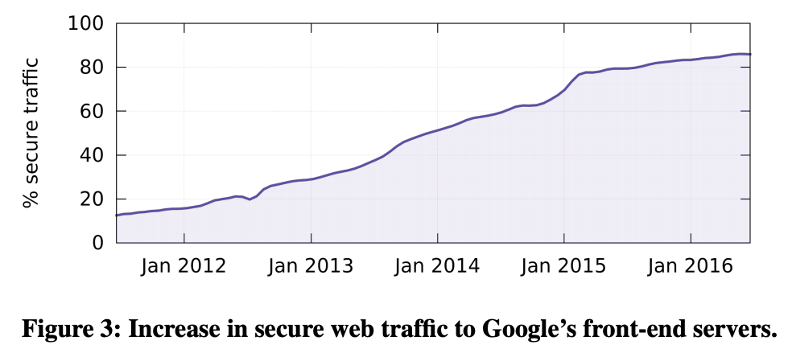
Layered designs create constraints
Lower layers cannot be controlled by upper layers (cost of abstraction)
Some hacks exist, like TCP connection parameters allowing application to enable/disable Nagle’s algorithm.
Vast majority of Internet traffic is HTTP+TLS+TCP+IP
We can improve performance significantly by combining some of these protocols.
At right, we see that nowadays most web traffic is encrypted.
Protocols should be designed to make the common case as efficient as possible.

Slide 11
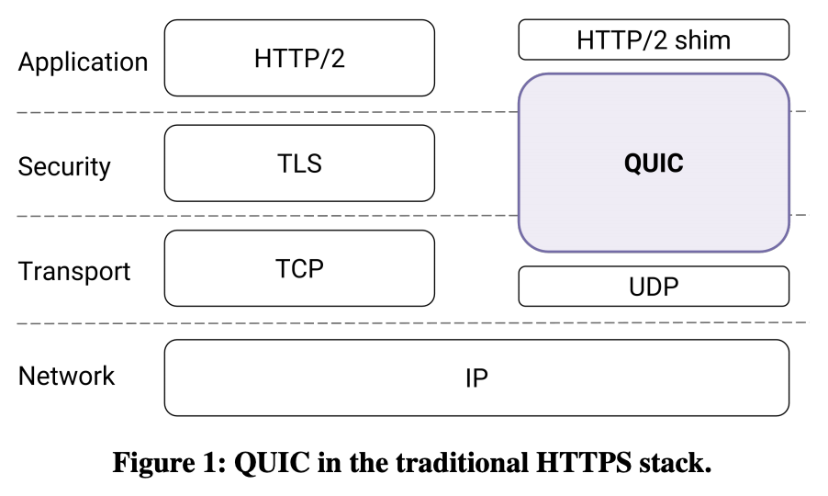
Quick UDP Internet Connections
Replaces TLS and TCP.
QUIC was designed alongside a new version of HTTP to work with it.
Development started at Google in 2012
Deployed in their Chrome browser, and services like YouTube.
5-10% of current Internet traffic is QUIC, as of late 2018.
Wireshark trace on your machine will show QUIC traffic if you use Chrome
HTTP-over-QUIC will be renamed to “HTTP version 3”
IETF announced this on November 2018 (both names are used nowadays).
QUIC is based on lessons learned from SPDY and HTTP/2
Solves problems caused by abstracting and isolating network layers ….

Slide 12
Why UDP?
UDP allows the user-level application to control each packet.
QUIC implements reliable transport in an application library, rather than letting the OS’s TCP library handle it.
QUIC implements retransmission, handshakes, pacing, etc. on top of UDP.
This allows Google’s Chrome browser to include QUIC without modifying the underlying OS.
Ideally, it would make sense for QUIC to be implemented as an alternative to UDP and TCP, directly on top of the IP layer.
However, existing routers, firewalls, NATs don’t know about QUIC.
Lesson from IPv6: incompatibility with old hardware will block adoption.
Like Project 2!

Slide 13
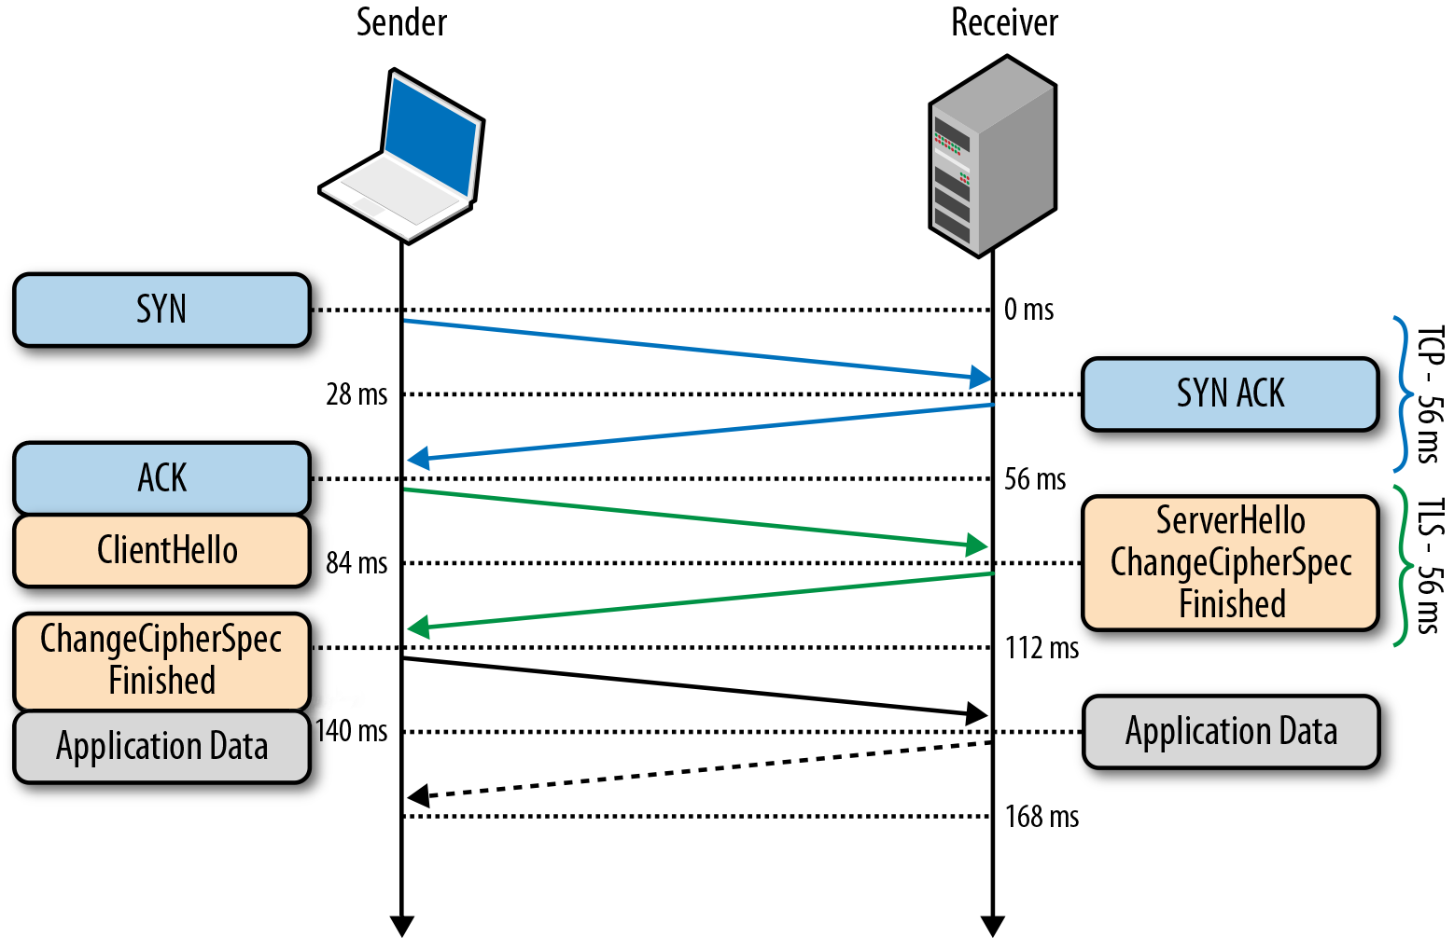
TCP/TLS Problem #1: Two Handshakes
TLS cannot start its key exchange until after the TCP handshake
The speed of light is a hard limitation, so latency will become the dominant factor influencing performance of future networks.

Slide 14
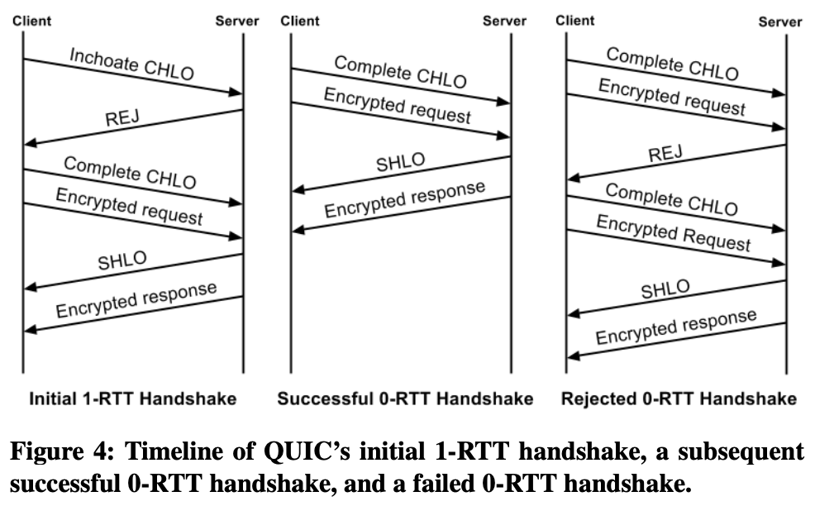
QUIC Handshakes
CHLO = Client Hello
REJ = Rejection
Worst case: combine TCP+TLS handshakes.
Send public key and other encryption parameters in the first packet.
Server “REJ” response provides pub key.
Best case: zero-RTT handshake
Remember long-lived public key from previous connection to the same server.
Send encrypted request along with the client’s pub key.

Slide 15
HTTP Problem #2: Multiple streams are expensive
Web browsers make many requests to load a page:
Initial HTML page, plus many CSS, Javascript, AJAX, and Image requests, all of which might be retrieved from the same server.
Each request needs:
its own TCP+TLS connection (with significant handshake setup latency),
or to wait for an existing request to finish, in order to reuse its connection.
SPDY and HTTP/2 solved this problem by multiplexing many HTTP connections on a single TCP/TLS socket:
Allows a single socket to handle many HTTP requests in parallel.
Adds a stream id to distinguish multiple streams in a single socket.
HTTP/2 is used in about 50% of web traffic.

Slide 16
HTTP/1.1
Multiple TCP/TLS handshakes are required
Client must read response before making requests for related content.

Slide 17
HTTP/2
Only one TCP/TLS connetction/handshake is required for multiple HTTP requests.
Latency of later requests is reduced, due to connection reuse.
Fewer TCP port numbers are reserved on the client side

Slide 18
HTTP/2 with Server Push
Server predicts that client will request certain documents next.
Multiple responses are sent along with the initial request and cached locally.
Client will use the predictively cached responses if necessary.
Notes:
Push was just added to Nginx in Feb 2018. Not as widely adopted as HTTP/2 stream multiplexing.

Slide 19
HTTP/1.1 vs HTTP/2 (multiple streams)

Slide 20
HTTP/2 over TCP is prone to head-of-line blocking
Remember that TCP is a stream-oriented protocol.
If a packet is dropped, then later packets in the stream can be buffered by the receiver, but they cannot be delivered up the to application layer until the dropped packet is retransmitted and received.
In other words, the application must receive data in order (in a stream).
HTTP/2 transmits many HTTP requests’ data in a single TCP stream.
The dropped packet may involve only one (or a subset) of the HTTP streams, so it’s not necessary to block them all. TCP forces this!

Slide 21
Head-of-line blocking (in general)
Example in a switch or router:
HOL blocking is when an item at the head of a queue unnecessarily blocks items behind it.
At right, two input ports are trying to use Output 4.
If Input 3 is chosen to proceed, then Input 1 will have to wait.
Thus, the next item in Input 1’s queue (destined to the idle Output 3) is stuck waiting for no good reason.
The fundamental problem is that we’re using a FIFO queue for items with no ordering dependence. We should pop whichever item is ready.

Slide 22
HTTP/2 head-of-line blocking illustration
(eg., three different web images)
OS will not deliver data in later segments to application until after segment 3 is retransmitted.
TCP segment 3 is lost in transit.
Data in segments 4,5,6 is for HTTP/2 responses unrelated to the lost segment.
There’s no need to wait, but the abstraction provided by TCP forces the wait.

Slide 23
QUIC prevents head-of-line blocking
By coordinating transport and application layers, QUIC can allow HTTP streams unaffected by a packet loss to continue while delaying those that must be delayed.
QUIC data is sent by UDP, so it’s not buffered by the OS to be delivered “in the right order.”
In other words, QUIC uses one handshake to support an arbitrary number of independent data streams.

Slide 24
Problem #3: HTTP headers are inefficient
Human-readable headers in HTTP waste space.
Eg., “Content-Length:” is 15 bytes = 120 bits!
Compare to DNS, which is very space-efficient.
Gzip compression of HTTP body is possible using a Content-Encoding header, but headers are always plain ASCII text.
Some headers (specifying client capabilities) are repeated in each new request to the server (because HTTP is stateless).
QUIC solution:
Compress headers, using a scheme called QPACK.
Downside: Lose human-readablilty. Must debug w/a tool like Wireshark.

Slide 25
Problem #4: Mobility
Mobile radios are often shut off, disconnecting TCP sessions.
Mobile device may re-join the network with a different IP address.
QUIC uses unique connection IDs:
When a device moves (eg., from cellular to WiFi), it can resume a connection (eg., streaming a YouTube video) by using the same QUIC connection ID on a different IP address (and UDP port).
Ie., a connection can continue even if client IP address changes.

Slide 26
Compatibility with HTTP/1.1 and TCP
Web servers need not change to support QUIC or HTTP/2.
Can put a reverse-proxy or load-balancer in front of basic webserver.
This is already commonly done to add TLS to web connections.
For example, Nginx supports HTTP/2, unstable release supports QUIC.
An HTTP-over-QUIC stream can be logically translated into HTTP/1.1 requests.
Port type and number?
One machine running two processes:
QUIC handshake
QUIC Reverse Proxy
HTTP/1.1 Web Server
UDP port 80
GET http://localhost:8080/page
TCP port 8080
GET http://site.com/page
200 OK… [response data]
200 OK… [response data]
Port type and number?

Slide 27
References
https://dl.acm.org/citation.cfm?id=3098842
https://www.zdnet.com/article/http-over-quic-to-be-renamed-http3/
https://docs.google.com/document/d/1RNHkx_VvKWyWg6Lr8SZ-saqsQx7rFV-ev2jRFUoVD34/edit
https://tools.ietf.org/html/draft-ietf-quic-transport-13
https://tools.ietf.org/html/draft-ietf-quic-http-13
https://tools.ietf.org/html/draft-ietf-quic-qpack-01
https://freecontent.manning.com/animation-http-1-1-vs-http-2-vs-http-2-with-push/

Slide 28
Recap
The networking stack is layered for historical reasons and for simplicity
But all abstractions have limitations, including TCP.
QUIC moves transport to the application layer to solve many modern problems, using modern assumptions about networks:
Loading a website requires many HTTP requests.
RTTs are dominant factor in network performance.
Devices move.
Encryption is standard, not optional!

Slide 29
Follow-up courses
CS-397/497 Wireless Protocols for the Internet of Things
CS-397/497 Internet-scale Experimentation
CS-450 Internet Security
CS-396 Intro to Cryptography
CS-310 Scalable Software Architectures
CS-345 Distributed Systems
COMP_ENG-364 Internet of Things
To learn about the latest networking research:
Check out articles published at recent SIGCOMM conferences:
http://conferences.sigcomm.org/sigcomm/2020/program.html

