Slide 1
CS-340 Introduction to Computer Networking Lecture 4: Domain Name Service
Steve Tarzia
Many diagrams & slides are adapted from those by J.F Kurose and K.W. Ross

Slide 2
Last Lecture
Application-layer protocols are usually built on top of TCP
Don’t have to worry about network itself, just connect with other hosts
Most applications use a client-server architecture: request-response.
A peer-to-peer architecture is more scalable, but difficult to organize.
HTTP was invented for fetching documents from web servers.
It’s now used as the basis for many request-response interactions.
URLs, request method, response status, human-readable headers, body
REST APIs are built on top of HTTP, so it’s a layer in its own right.
SMTP is an earlier application-layer protocol, for sending email
Unlike HTTP, it’s stateful (server has to remember what you previously said).

Slide 3
Third party cookies, pixels, and tags
Recall, that an HTTP response may include a cookie.
Cookies are random strings stored by your browser and included in every request to the same domain.
Cookies are a way for the browser to remind a website of your identity.
Third party cookies are cookies from a domain different that the currently viewed web page.
Often enabled with a one-pixel GIF image included in the page:
<img src="https://facebook.com/tracker/pix.gif">
Causes browser to send a request to facebook.com (including your Facebook cookie) even though I’m visiting a page unrelated to Facebook.
The request has a “Referer:” header listing the current URL.
Thus, Facebook (for example) learns about much of your web activity.

Slide 4
Visiting Northwestern’s webpage (w/Ghostery plugin)

Slide 5
New York Times homepage (allowing all cookies)

Slide 6
New York Times homepage (allowing all cookies)

Slide 7
New York Times homepage (allowing all cookies)

Slide 8
New York Times homepage (allowing all cookies)

Slide 9
New York Times homepage (allowing all cookies)

Slide 10
Cookies are secrets!
Remember that web servers use cookies to authenticate (identify) users.
If I steal your browser’s cookies and copy them to my browser, then any websites I visit recognize me as you.
Web browsers isolate cookies by domain.
Cookies have expiration dates.
This is why you have to re-sign-in to websites occasionally, even if you did not sign out.
Signing out involves clearing your browser’s cookies and removing the cookies from a server-side database.

Slide 11
Cross-Site Request Forgery (CSRF) attack
Cookies must be carefully configured to prevent attacks.
Eg., I can place the following code in my website to trigger an authenticated request to another website:
<img src="https://mybank.com/transfer? account=bob&amount=1000000&to=mallory">
The browser will include that domain’s cookies in the request, and those cookies authenticate the request.
There is also a variation of this attack that uses a hidden HTML form to generate a POST request.
Cookies can be stored with “SameSite” attribute to prevent CSRF, and many other protection strategies are possible.

Slide 12
Domain Name Service (DNS)
Internet hosts are reachable by IP address:
eg.: 129.105.136.70 (IPv4) or 2001:db8::ff00:42:8329 (IPv6)
But we need some way to find these addresses.
DNS maps from human-friendly hostnames to IP addresses
Eg., “northwestern.edu” → 129.105.136.70
IP addresses are bound to machines.
Hostnames are associated with services.
More permanent than IP addresses (allows machines to move).
DNS provides a layer of indirection in addressing, useful in many ways.
Defined in RFCs 1034 and 1035

Slide 13
IP Addresses are for routing
Actually, this is a gross simplification of how routing works. We have two chapters dedicated to IP routing.
Nearby IP addresses are usually physically closer together in the network.
Left-most bits are for global location, right-most bits are local.
Similar to telephone numbers: 1-847-491-7069
USA, NE Illinois, Northwestern campus, Steve’s phone

Slide 14
DNS is a global Internet directory

Slide 15
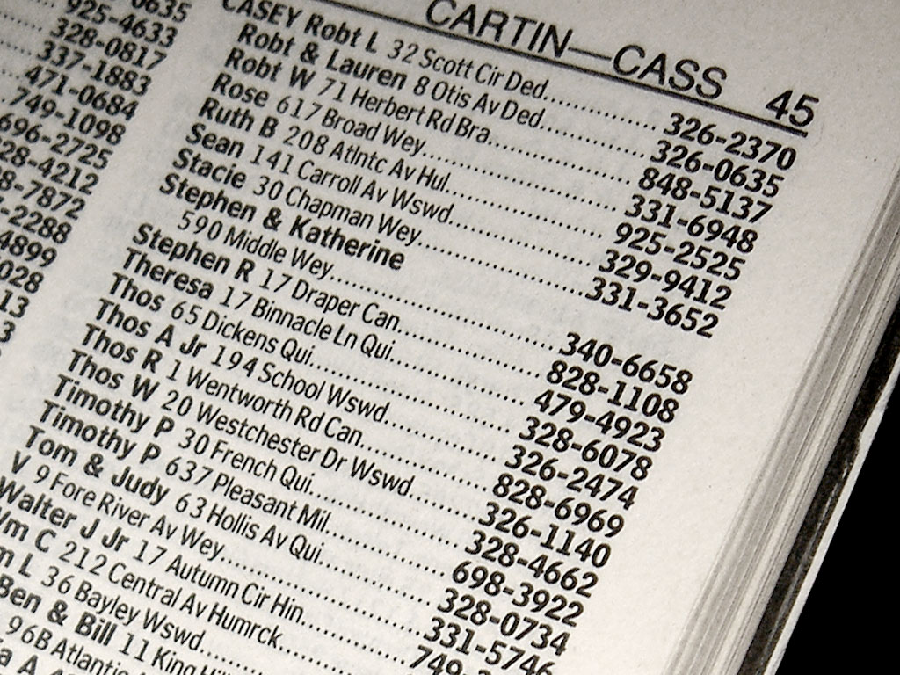

Slide 16
DNS scaling
A single directory machine would not scale
Many web requests require a DNS lookup first.
One server cannot handle all the Internet’s directory requests!
Plus, you want to do this lookup at a nearby server.
How would you make DNS scalable, to provide IP address lookups for all machines on the Internet?
Two basic solutions:
Distribute the database across many machines.
Cache DNS lookups locally on the client and in nearby caching proxies.
STOP and THINK

Slide 17
DNS is distributed and hierarchical
Root DNS Servers
…
…
Top-level domains:
(TLDs)
org DNS servers
edu DNS servers
com DNS servers
pbs.org
DNS servers
northwestern.edu
DNS servers
poly.edu
DNS servers
stevetarzia.com
DNS servers
yahoo.com
DNS servers
amazon.com
DNS servers
kellogg.northwestern.edu
DNS servers
cs.northwestern.edu
DNS servers
Each DNS server only knows about the records in its own subdomain
These are the authoritative nameservers for the various subdomains.
If I want to own and operate “stevetarzia.com” I must pay someone to add a record to the “com” top-level-domain nameservers.
I then can run my own nameserver on my subdomain, defining:
www.stevetarzia.com, mail.stevetarzia.com, and even citibank.stevetarzia.com (for phishing purposes).

Slide 18
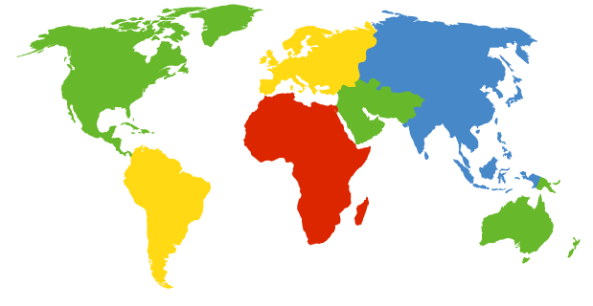
13 Root DNS servers (run by ICANN)
Each Root DNS Server is actually redundant across many physical locations using IP anycast.
More on this later!
These store IP addresses of the nameservers for all the top-level-domains (TLDs): com, net, uk, edu, cn, etc.
c. Cogent, Herndon, VA (5 other sites)
d. U Maryland College Park, MD
h. ARL Aberdeen, MD
j. Verisign, Dulles VA (69 other sites )
k. RIPE London (17 other sites)
i. Netnod, Stockholm (37 other sites)
e. NASA Mt View, CA
f. Internet Software C.
Palo Alto, CA (and 48 other sites)
m. WIDE Tokyo
(5 other sites)
a. Verisign, Los Angeles CA
(5 other sites)
b. USC-ISI Marina del Rey, CA
l. ICANN Los Angeles, CA
(41 other sites)
g. US DoD Columbus, OH (5 other sites)

Slide 19
Querying the DNS hierarchy
root DNS server
Client wants IP address of cs.umass.edu
Query iteratively, starting with the root server:
Each server replies with an answer or the name of server to contact:
“I don’t know this name, but ask this server.”
Performance problems?
Every request hits the root server.
Common domains, like google.com are queried billions of times per day!
1
2
TLD DNS server
for “edu”
3
4
client
dhcp123.northwestern.edu
6
5
STOP and THINK
authoritative DNS server for
“umass.edu”
cs.umass.edu

Slide 20
Local DNS Resolver
Not an authoritative nameserver and not part of the DNS hierarchy.
Just a caching proxy.
root DNS server
Key observation:
A few domains are very popular, and your neighbors are probably accessing the same set of services.
Local DNS resolver is a caching proxy:
A proxy is just an intermediary or "middleman" for a request.
Caching is saving recent responses so they can be reused without doing all the work to generate them again.
ISPs operate DNS resolvers for their customer.
2
3
TLD DNS server
for “edu”
4
5
local DNS server
dns.northwestern.edu
7
6
1
8
authoritative DNS server for “umass.edu”
requesting host
dhcp123.northwestern.edu
cs.umass.edu

Slide 21
Side note: an unlikely alternative
root DNS server
A very polite DNS server may actually recursively look up the answer to our query, even if it is not the authoritative server for that domain.
DNS servers are rarely so kind.
This does not happen in practice.
3
2
7
6
TLD DNS server
for “edu”
3
local DNS server
dns.northwestern.edu
5
4
1
8
authoritative DNS server for
“umass.edu”
requesting host
dhcp123.northwestern.edu
cs.umass.edu

Slide 22
DNS Record Time to Live (TTL)
Why not always set the TTL to a very low value?
STOP and THINK
DNS is a distributed system, and query responses are cached (remembered) at the “edge” of the network.
This allows repeated and common queries to be answered quickly, without asking the authoritative nameserver.
Eg., if I ask my local nameserver the IP address of google.com, I will likely get a cached answer immediately, because someone probably queried it recently.
However, records cannot be cached forever – this would make the system static. Changes in the authoritative server would never be seen.
DNS records have a Time to Live (TTL) indicating when they expire.
After expiry, must ask the authoritative nameserver for the updated value
TTL typically = 300 to 86400 seconds (5 minutes to 24 hours)

Slide 23
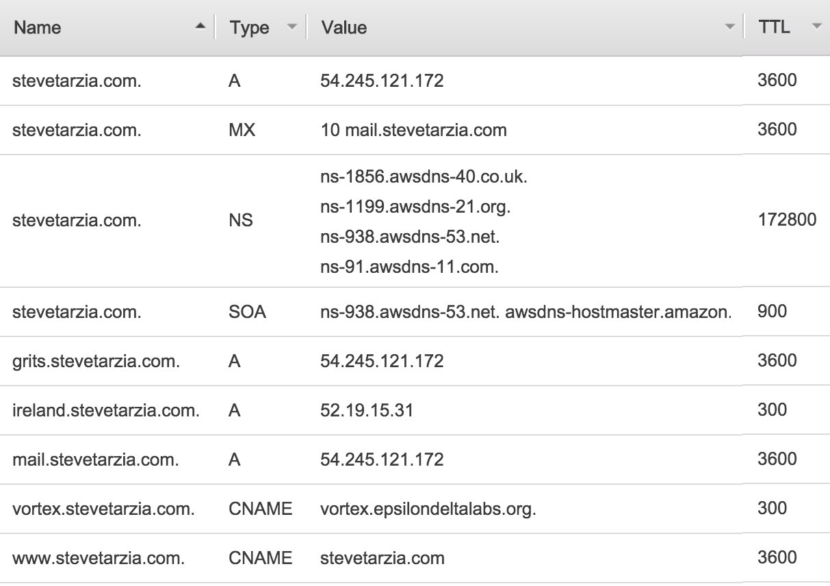
DNS contents
Records:
Name
Value
Type
TTL

Slide 24
DNS has different types of records, for different uses
A records: map hostnames to IP addresses
grits.stevetarzia.com → 54.245.121.172
AAAA records do the same for IPv6
NS records: lists the nameservers for a given domain
These records are present in the parent domain’s nameserver.
Authoritative nameservers for “com” store the NS records for “stevetarzia.com”
MX records: list the email servers
To whom should I send mail addressed to strongbad@stevetarzia.com?
Several servers can be listed, with numbers indicating the priority of each one.
CNAME records: list aliases
www.stevetarzia.com → stevetarzia.com

Slide 25
Advanced DNS records
SOA records store information about who created the DNS records and how they should be cached.
SRV records list server for a specified service (generalization of MX):
_sip._udp.columbia.edu → laurel.cc.columbia.edu:5060
Tells us which server handles VoIP phone calls to user@columbia.edu.
_minecraft._tcp.stevetarzia.com → …
TXT records are a generic key-value store
DKIM records (stored in a TXT record) store email signature public key:
key1._domainkey.example.com → k=rsa;p=J8eTBu224i086iK
SPF records list valid outbound mail servers for the domain
PTR records store reverse DNS records, IP address → hostname

Slide 26
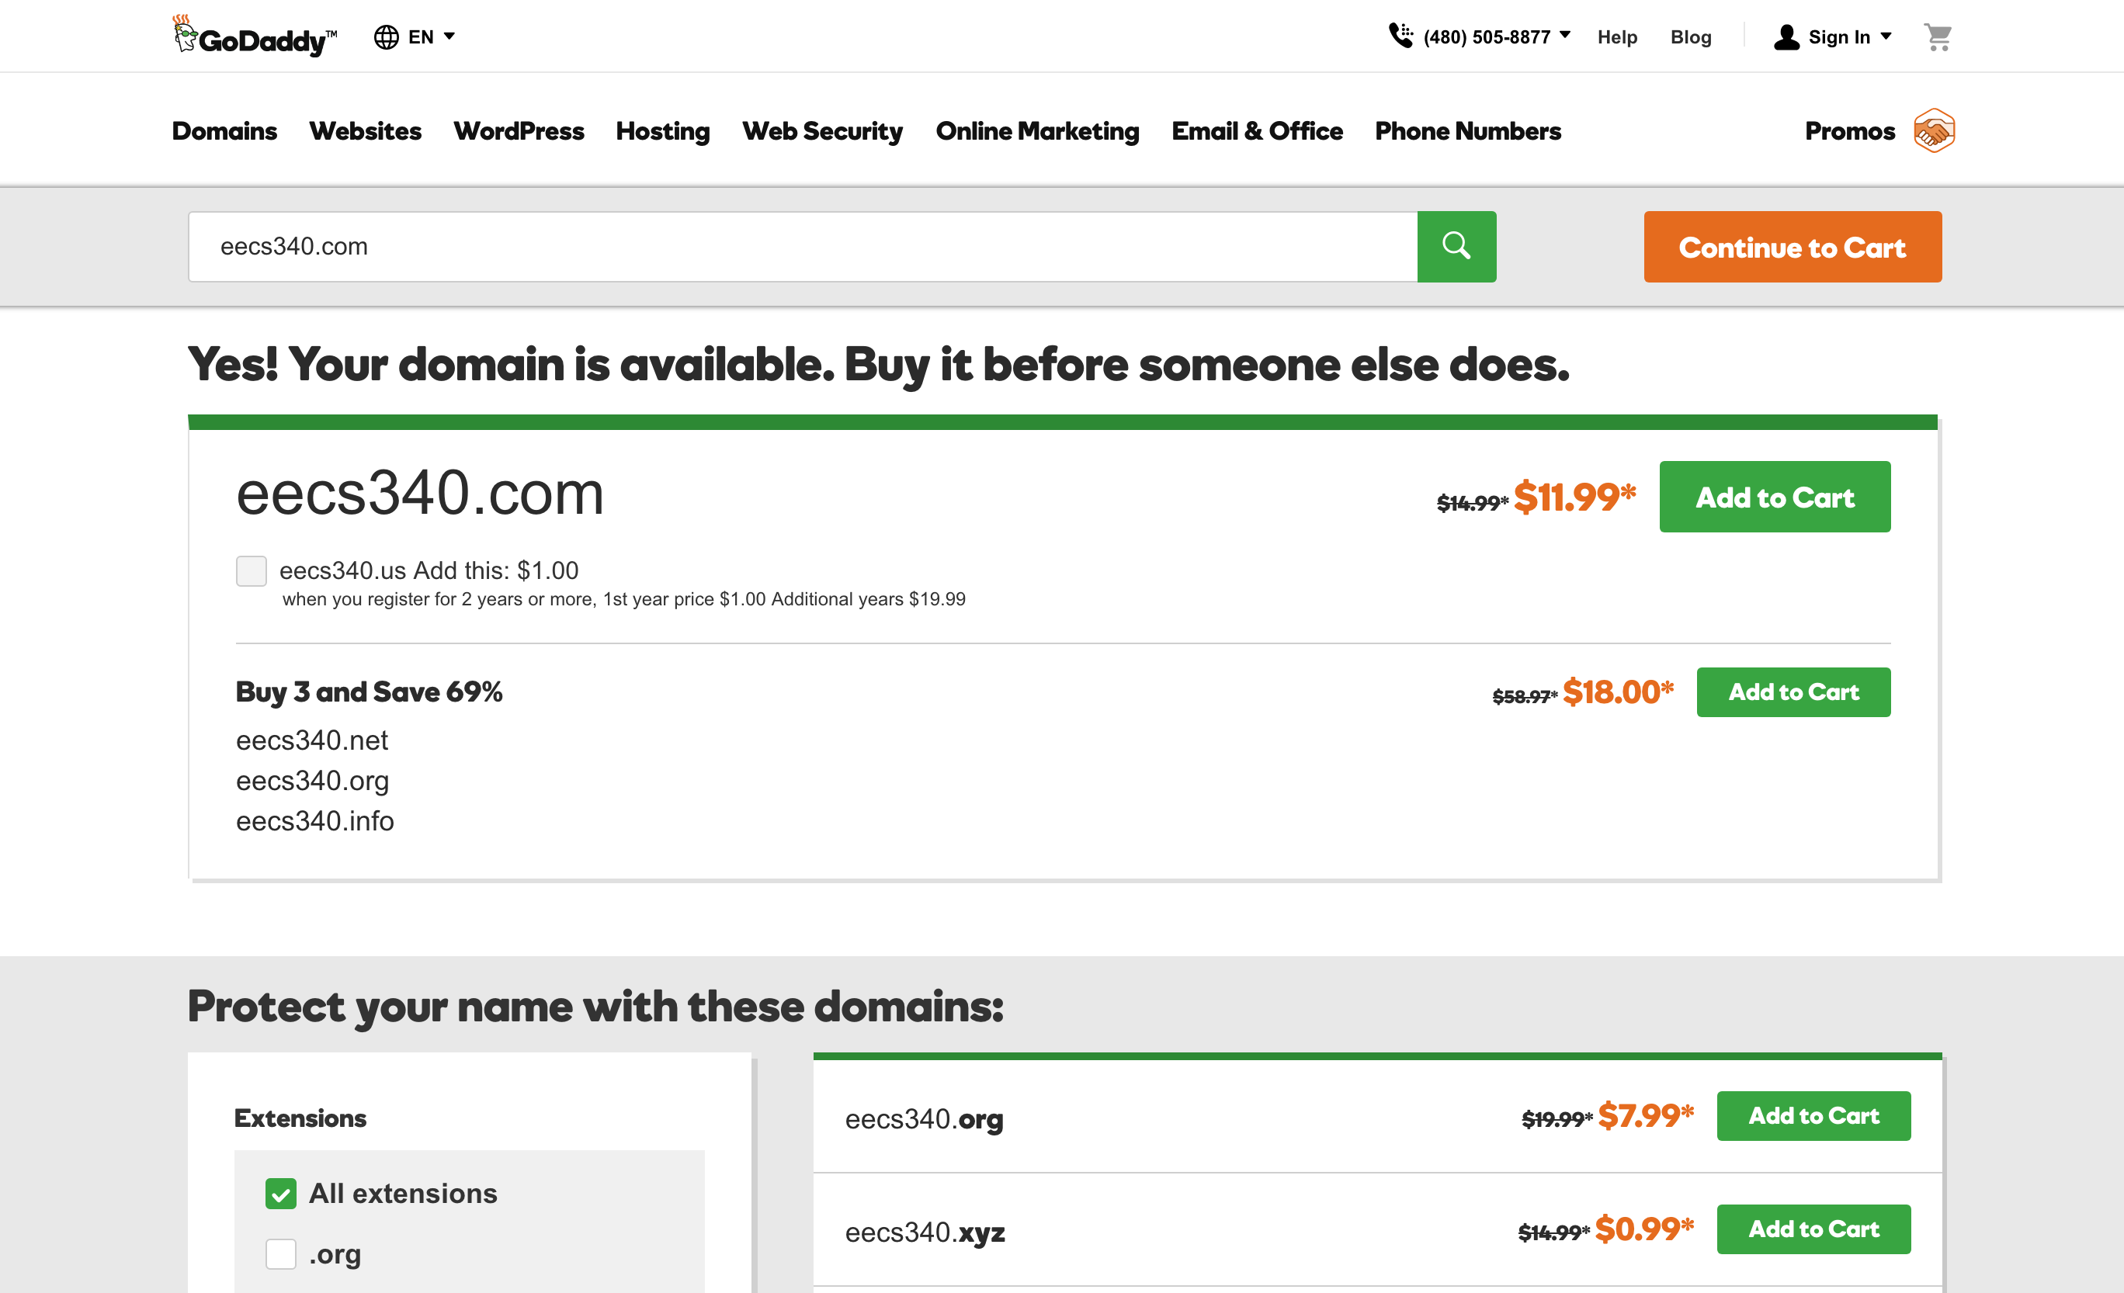
STOP and THINK
Technically, what is the result of my buying a domain? Where is domain ownership defined?

Slide 27
Domain Name Registrars sell domain names
Eg., GoDaddy, Namecheap, AWS.
Must be accredited (approved) by the TLD registry:
ICANN appoints an organization to manage each TLD.
Eg., .com TLD is managed by Verisign, Inc.
100 million .com domains (in 2011).
Registrar collects your money and your nameserver list, and causes it to be stored by the TLD.
ICANN collects an 18 cent fee.

Slide 28
Advanced DNS
Modern DNS is much more than just a directory.
It’s is a valuable tool for managing delivery of Internet services:
Decides how to connect clients and servers
DNS records may change over time (allowing services to move)
Nameservers may give different answers to different clients!
Simple nameservers are static (always return the same answer), but dynamic nameservers may be more clever

Slide 29
Round Robin DNS
DNS can return multiple records for a given query.
A domain like www.ebay.com can map to many different IP addresses (machines)
This allows many machines to share the responsibility of answering requests (load balancing).
This works well for web traffic because HTTP is stateless.
For very large services, dynamic nameserver may return a random subset of IP addresses capable of handling a request.
Load-balancing nameserver may also monitor the health of servers to exclude IP addresses that are not responding.
TTL must be very short for this to work well.

Slide 30
Global Internet performance
Recall that packet delivery time is influenced by number of network hops (nodal delays) and length of links (propagation delay).
Latency is high for distant servers.
It is much faster to access a nearby server, especially for applications like the web, that involve dozens of small requests.

Slide 31
Sending a packet to China
$ nslookup www.tsinghua.edu.cn
Server: 192.168.0.1
Address: 192.168.0.1#53
Non-authoritative answer:
www.tsinghua.edu.cn canonical name = www.d.tsinghua.edu.cn.
Name: www.d.tsinghua.edu.cn
Address: 166.111.4.100
$ ping 166.111.4.100
PING 166.111.4.100 (166.111.4.100): 56 data bytes
64 bytes from 166.111.4.100: icmp_seq=0 ttl=233 time=401.758 ms
64 bytes from 166.111.4.100: icmp_seq=1 ttl=233 time=219.958 ms
64 bytes from 166.111.4.100: icmp_seq=2 ttl=233 time=220.512 ms
64 bytes from 166.111.4.100: icmp_seq=3 ttl=233 time=223.185 ms

Slide 32
Sending a packet to Lemont, Illinois
$ nslookup www.anl.gov
Server: 192.168.0.1
Address: 192.168.0.1#53
Non-authoritative answer:
Name: www.anl.gov
Address: 146.137.23.18
$ ping 146.137.23.18
PING 146.137.23.18 (146.137.23.18): 56 data bytes
64 bytes from 146.137.23.18: icmp_seq=0 ttl=242 time=27.578 ms
64 bytes from 146.137.23.18: icmp_seq=1 ttl=242 time=22.076 ms
64 bytes from 146.137.23.18: icmp_seq=2 ttl=242 time=15.406 ms
64 bytes from 146.137.23.18: icmp_seq=3 ttl=242 time=15.370 ms

Slide 33
Evanston apartment to Beijing route
$ traceroute 166.111.4.100
traceroute to 166.111.4.100 (166.111.4.100), 64 hops max, 52 byte packets
1 (192.168.0.1) 3.981 ms 2.138 ms 1.804 ms
2 96.120.29.37 (96.120.29.37) 10.648 ms 10.112 ms 9.856 ms
3 te-0-7-0-11-sur03.mortongrove.il.chicago.comcast.net (68.87.209.245) 9.873 ms 10.544 ms 10.410 ms
4 162.151.36.238 (162.151.36.238) 10.365 ms 10.320 ms 10.812 ms
5 be-141-ar01.area4.il.chicago.comcast.net (162.151.36.241) 12.360 ms 15.856 ms 12.299 ms
6 be-33491-cr02.350ecermak.il.ibone.comcast.net (68.86.91.165) 12.240 ms 23.751 ms 13.067 ms
7 ix-xe-8-0-0-2-0.tcore1.ct8-chicago.as6453.net (64.86.137.45) 11.884 ms 18.908 ms 19.186 ms
8 if-ae-29-2.tcore2.sqn-san-jose.as6453.net (64.86.21.104) 88.461 ms 73.921 ms 74.453 ms
9 if-ae-1-2.tcore1.sqn-san-jose.as6453.net (63.243.205.1) 73.931 ms 74.063 ms 82.372 ms
10 if-ae-38-2.tcore2.sv1-santa-clara.as6453.net (63.243.205.75) 73.271 ms
11 if-ae-0-2.tcore1.sv1-santa-clara.as6453.net (63.243.251.1) 73.662 ms 74.222 ms 80.777 ms
12 if-ae-8-2.tcore1.lvw-los-angeles.as6453.net (66.110.59.8) 74.468 ms 93.983 ms 85.666 ms
13 66.110.59.182 (66.110.59.182) 75.365 ms 77.409 ms 77.519 ms
14 101.4.117.213 (101.4.117.213) 300.917 ms 261.717 ms 312.424 ms
15 101.4.117.101 (101.4.117.101) 307.725 ms 328.299 ms 311.348 ms
16 101.4.115.254 (101.4.115.254) 306.925 ms 378.022 ms 293.795 ms
17 101.4.112.197 (101.4.112.197) 219.399 ms 240.069 ms 306.198 ms
18 * * *

Slide 34
Northwestern Campus to Beijing route
$ traceroute 166.111.4.100
traceroute to 166.111.4.100 (166.111.4.100), 64 hops max, 52 byte packets
1 tech-6-vln-498.northwestern.edu (129.105.5.5) 9.108 ms
tech-5-vln-498.northwestern.edu (129.105.5.4) 0.584 ms
tech-6-vln-498.northwestern.edu (129.105.5.5) 0.592 ms
2 2020rdg-4-prt-242.northwestern.edu (129.105.247.94) 0.737 ms
lev-5-po242.northwestern.edu (129.105.247.92) 0.648 ms
lev-5-po243.northwestern.edu (129.105.247.14) 0.634 ms
3 abbt-2-vln-2341.northwestern.edu (129.105.253.94) 1.109 ms 1.520 ms 0.975 ms
4 abbt-5-xe-1-0-3.northwestern.edu (129.105.247.231) 1.506 ms
abbt-5-xe-2-0-3.northwestern.edu (129.105.247.225) 1.583 ms
abbt-5-xe-1-0-3.northwestern.edu (129.105.247.231) 1.527 ms
5 starlight-lsd6509.northwestern.edu (199.249.169.6) 1.528 ms 2.268 ms 1.567 ms
6 et-7-0-0.1136.rtsw.star.net.internet2.edu (198.71.46.206) 1.696 ms 1.542 ms 1.464 ms
7 et-2-1-0.4079.rtsw.chic.net.internet2.edu (162.252.70.116) 3.450 ms 2.114 ms 1.778 ms
8 ae-3.4079.rtsw.kans.net.internet2.edu (162.252.70.141) 13.860 ms * 13.021 ms
9 ae-5.4079.rtsw.salt.net.internet2.edu (162.252.70.145) 32.994 ms 33.189 ms 34.230 ms
10 * ae-1.4079.rtsw.losa.net.internet2.edu (162.252.70.114) 45.478 ms 45.611 ms
11 210.25.189.133 (210.25.189.133) 51.453 ms 48.035 ms 47.858 m
12 * * *
13 210.25.187.42 (210.25.187.42) 200.646 ms 200.820 ms 201.288 ms
14 210.25.187.45 (210.25.187.45) 200.391 ms 202.337 ms 200.467 ms
15 210.25.189.69 (210.25.189.69) 202.314 ms 200.980 ms 203.745 ms
16 101.4.115.254 (101.4.115.254) 199.979 ms 199.829 ms 202.220 ms
17 101.4.113.234 (101.4.113.234) 200.503 ms 200.646 ms 201.140 ms
18 * * *

Slide 35
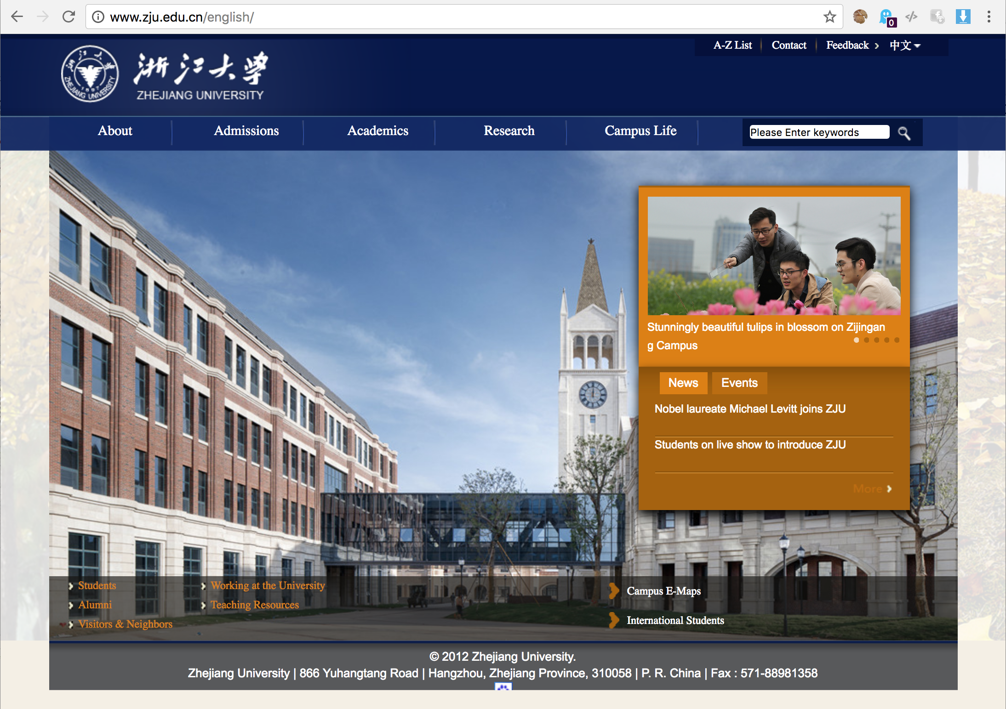
http://www.zju.edu.cn/english/

Slide 36
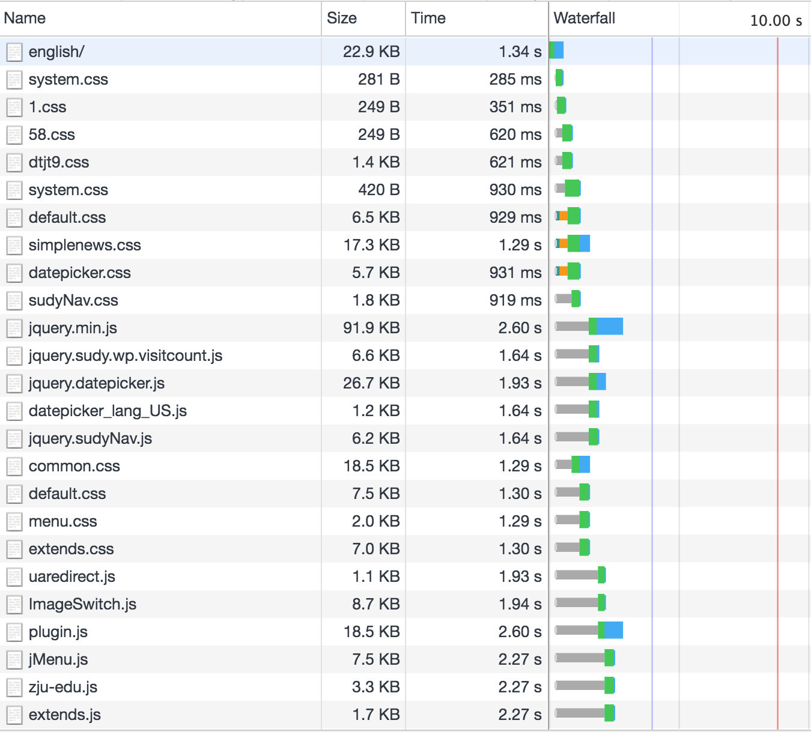
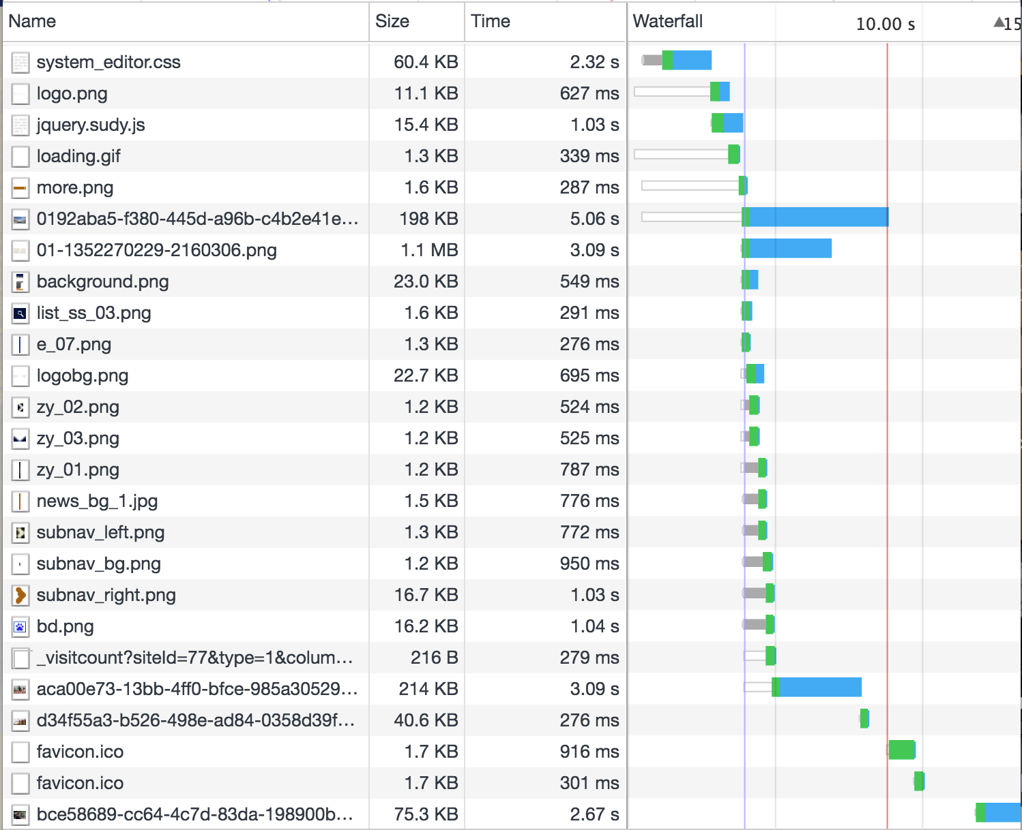

Slide 37
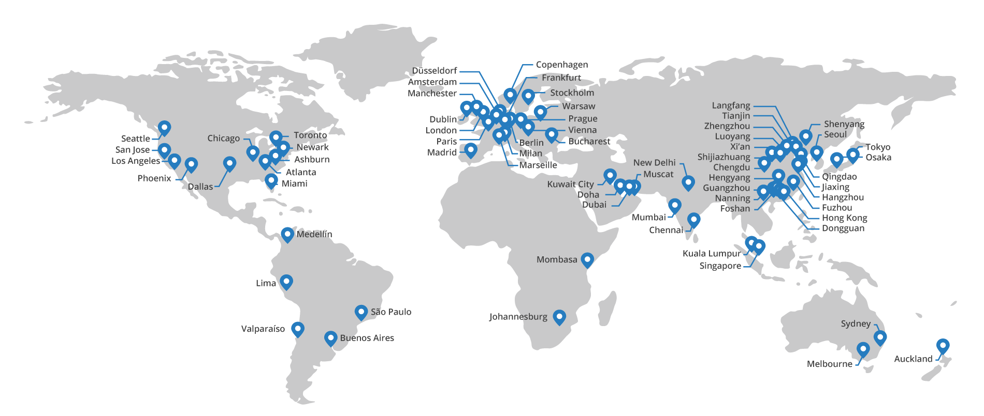
Content Delivery Network (CDN)
Globally distributed servers that cache HTTP responses for local clients.
Special DNS server examines IP address of requester and resolves to the server that it thinks is closest to the client (IP address geolocation).
Eg., Akamai, Cloudflare, Cloudfront
Distributed “edge” servers

Slide 38
CDN uses HTTP caching proxies
Origin Server is the original, central web server. (Sets cache-control HTTP headers in responses).
Edge Servers are caching proxies. Like DNS, ask origin server if don’t have a cached response.

Slide 39
CDNs are add-on services
Website operator manages origin server
CDN operator manages edge servers (Cloudflare, Akamai, Cloudfront)

Slide 40
Google public DNS
DNS is critical for most Internet applications.
Failure of your local nameserver is very often the source of “Internet outages” you may experience.
Google provides free public DNS servers at 8.8.8.8 and 8.8.4.4.
It’s a useful backup option if your local DNS resolver is not working.
Why does Google provide this service for free?
DNS requests tell them even more about your web surfing habits, and this helps their advertising business.
STOP and THINK

Slide 41
Captive portals also use DNS in a clever way

Slide 42
Recap
DNS is the Internet’s directory service
It’s distributed and hierarchical
Caching proxies are request intermediaries that store and reuse recent responses. Examples include DNS resolvers and CDNs.
Dynamic DNS server can cleverly craft their responses to provide:
Load balancing and fault tolerance in a cluster of servers
Content Delivery Networks, that direct you to the closest service “mirror”
Captive portals, that can hijack the entire Internet
But TLS encryption and PKI prevent spoofing of secure (https) sites.

