Slide 1
EECS-317 Data Management and Information Processing Lecture 8 – Relational Database Design Examples
Steve Tarzia
Spring 2019

Slide 2
Announcements
HW3 is due Monday.
Exam is in one week (Thurs May 2nd)
Tuesday’s lecture will be a midterm review

Slide 3
Last lecture: Relational Database Design
Primary and unique keys prevent rows from repeating certain columns.
Foreign keys link tables and point to primary/unique keys.
Create parent/child table relationships. Must fill in parent before child.
Parent rows cannot be deleted unless default foreign key behavior is changed.
Must kill children first!
Tables can represent Objects, Events (have time), and Relationships:
One to many relationships allow multiple child rows referencing one parent row
Implemented with a single foreign key.
Many to many relationships link two or more rows
Implemented with a linking table
One to one relationships create subset tables
Implemented with a single foreign key that is also a unique key.

Slide 4
Database Schema Design steps
List tables
(Objects, events, relationships)
Choose primary key for each table
Choose foreign keys to link tables
Add uniq keys and/or optional columns
Refine the design, revisiting decisions made above

Slide 5
On to the examples…

Slide 6
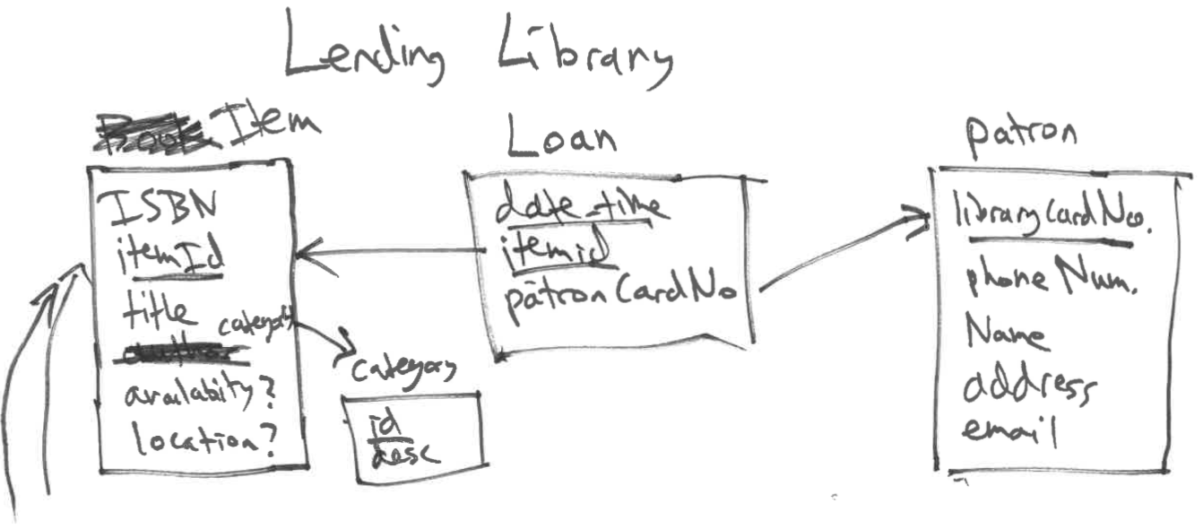
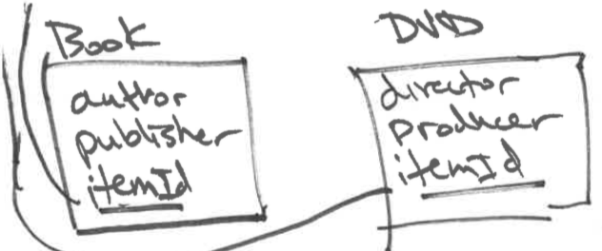

Slide 7
