Slide 1
EECS-317 Data Management and Information Processing Lecture 6 – Combining SELECTs, Advanced Predicates
Steve Tarzia
Spring 2019

Slide 2
Announcements
Second HW assignment due Monday night.
HW1 solutions will be posted soon.
Additional practice homework is posted in “files” section of Canvas. (Will not be graded.)

Slide 3
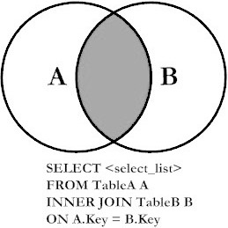
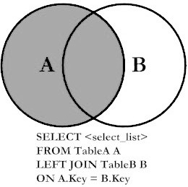
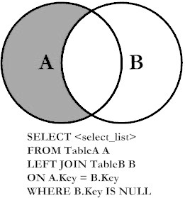
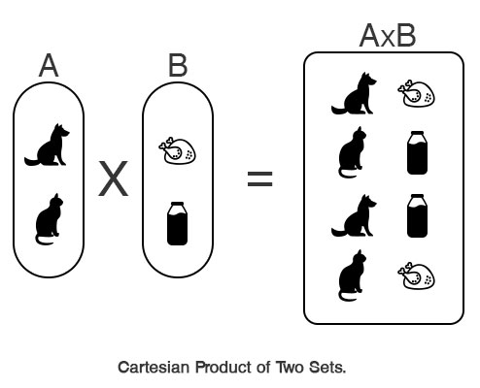
Last Lecture: OUTER and CROSS JOINs
Introduced different types of JOINs:
INNER (default): prints all pairs of rows (one from first table, one from second table) that satisfy the JOIN predicate.
LEFT: same as INNER, but adds rows from LEFT table that never satisfied the JOIN predicate.
LEFT with exclusion: only print rows from left table that never satisfied the JOIN predicate.
CROSS JOIN: print the cartesian project, meaning all rows from the first table combined with all rows from the second table. There is no “ON” to match rows.

Slide 4
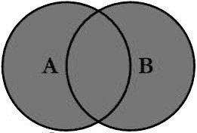
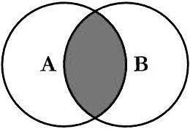
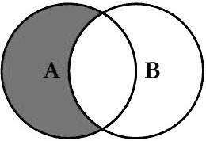
UNION, INTERSECT, and EXCEPT are used to combine two SELECT statements
UNION prints rows from either of two SELECTs (printing duplicates just once)
INTERSECT prints rows present in both SELECTs
EXCEPT prints rows present in one SELECT but missing from another SELECT

Slide 5
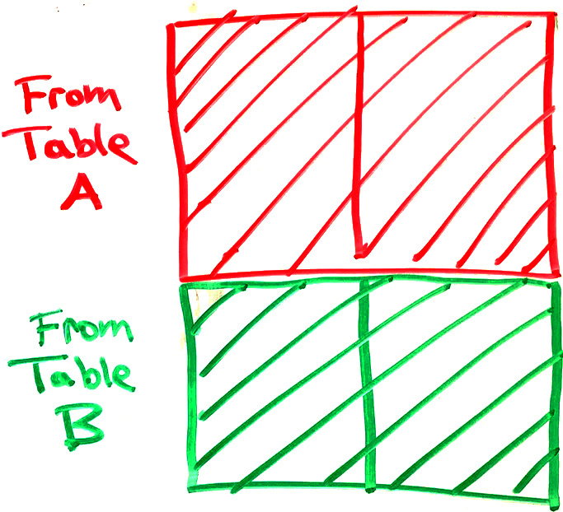
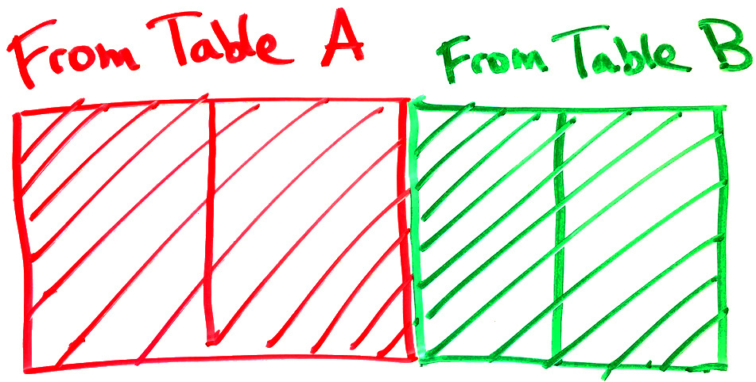
JOIN vs. UNION
JOINs combine tables horizontally.
Match rows from two tables based on one or more columns matching.
Creates a wider set of rows, adding columns from both tables.
JOIN:
UNION, INTERSECT, and EXCEPT combine result tables vertically
Number & type of columns in the two result tables must match
Changes the number of rows, not columns
UNION:

Slide 6
Details of combining SELECTs
UNION, INTERSECT, and EXCEPT all “combine” the results of two SELECT statements.
UNION is the simplest, it just prints all rows from both:
SELECT … UNION SELECT …
Duplicates are printed just once.
Each SELECT statement gets data from a different set of tables, otherwise it would be easier to just use a WHERE clause (with AND).
Left and right SELECT queries must return the same number of columns, and the matching columns must have compatible data types.
For example: list names of all the Customers and Employees:
SELECT CustFirstName FROM Customers UNION SELECT EmpFirstName FROM Employees

Slide 7
Misuses of UNION, INTERSECT, and EXCEPT
Two SELECTs are not necessary if you can get an answer from just one virtual table.
SELECT * FROM Staff WHERE name="Jane” UNION SELECT * FROM Staff WHERE name="John”;
simplify to:
SELECT * FROM Staff WHERE name="Jane" OR name="John”;
SELECT * FROM Student_Schedules NATURAL JOIN Students EXCEPT SELECT * FROM Student_Schedules NATURAL JOIN Students WHERE Grade IS NULL;
simplify to:
SELECT * FROM Student_Schedules NATURAL JOIN Students WHERE Grade IS NOT NULL;

Slide 8
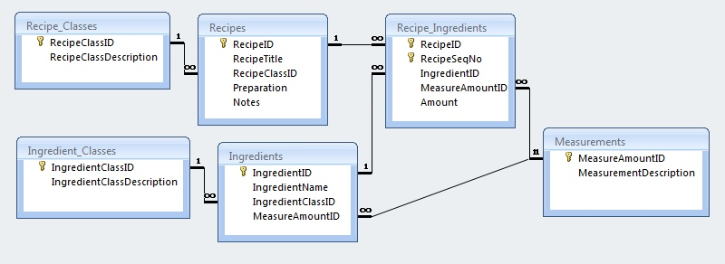
“Display missing types of recipes” (1 row)
SELECT RecipeClassDescription, SUM(RecipeID IS NOT NULL) AS RecipeCount FROM Recipe_Classes LEFT NATURAL JOIN Recipes GROUP BY RecipeClassID
HAVING RecipeCount = 0;
or SELECT RecipeClassDescription FROM Recipe_Classes WHERE RecipeClassID NOT IN (SELECT DISTINCT RecipeClassID FROM Recipes);
or
SELECT RecipeClassID FROM Recipe_Classes EXCEPT SELECT DISTINCT RecipeClassID FROM Recipes;
✅

Slide 9
Predicates in more detail
WHERE & HAVING filter rows according to conditions called predicates.
Any of the following can be combined, like an algebraic expression:
Binary operations (used between two things):
= != > < >= <= LIKE AND OR REGEXP ←(coming soon!)
+ - * / || % << >> & |
NOT …
… IS NULL, … IS NOT NULL
… BETWEEN … AND …
… IN (…,…,…)
(…)
Can also use all of the above in the columns we print out, and inside aggregations like SUM, MIN, MAX, AVG

Slide 10
Summing an indicator variable
Two ways to count recipes with “salsa” in description:
SELECT COUNT(*) FROM Recipes WHERE RecipeTitle LIKE "%salsa%”;
WHERE clause keeps just the rows matching “salsa,” then these rows are counted.
SELECT SUM(RecipeTitle LIKE "%salsa%") FROM Recipes;
A column is created for every recipe indicating whether its title matches “salsa” or not.
Column’s value will be 1 if it matches and 0 if not.
Sum of all the ones and zeros will be the count of matching recipes.
First approach is easier to understand, but second is shorter.

Slide 11
CASE conditional
Many programming languages have if … then … else … expressions.
SQL’s equivalent is CASE:
CASE WHEN … THEN … ELSE … END
Condition after WHEN is checked for true/false (1/0)
If the condition is true, then the expression after THEN is used
Otherwise (if the condition is false), then the expression after ELSE is used
For example, print firstName for children or Mr/Ms lastName for adults:
SELECT CASE WHEN age<18 THEN firstName ELSE (CASE WHEN gender="male" THEN "Mr. " ELSE "Ms. " END || lastName) END FROM people;

Slide 12
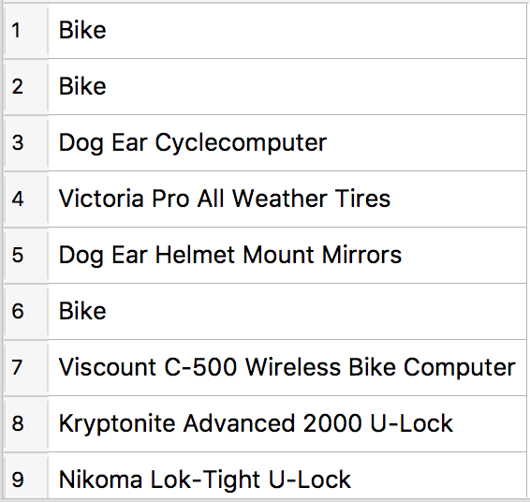
CASE in more detail
WHEN condition is tested for every row, giving true or false
SELECT CASE WHEN CategoryID=2 THEN "Bike" ELSE ProductName END FROM Products;
If condition is true then use the first value.
If condition is false then use the second value.
Output:

Slide 13
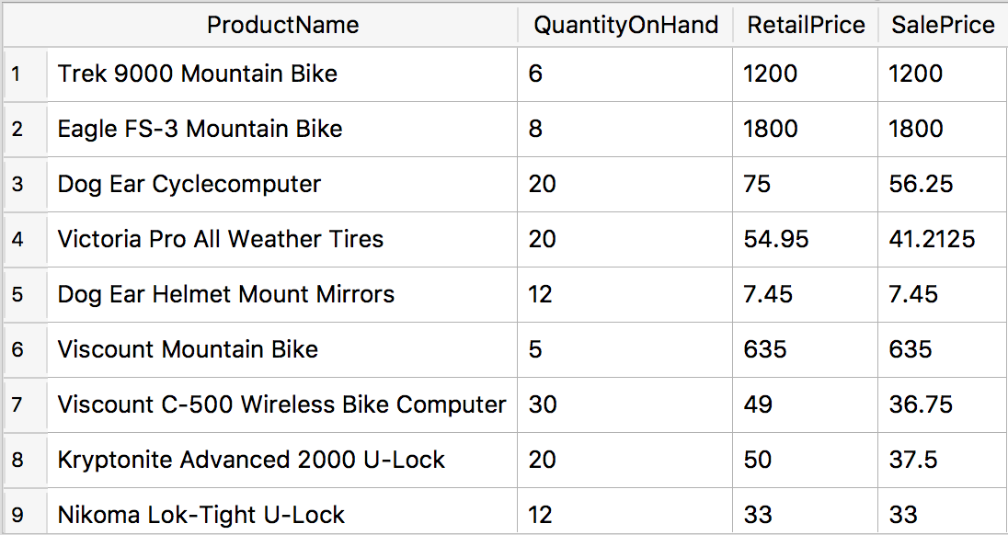
Another CASE example
Let’s say we want to print “sale prices” for products that are overstocked. Any products with 20 or more items in stock are discounted 25%, but other products remain at regular retail price.
SELECT ProductName, QuantityOnHand, RetailPrice, CASE WHEN QuantityOnHand >= 20 THEN 0.75*RetailPrice ELSE RetailPrice END AS SalePrice FROM Products;

Slide 14
CASE can also be used in filters
Print customers named “Martin” but refer to the first name in the friendly state of California and the last name elsewhere.
SELECT * FROM Customers WHERE CASE WHEN CustState = "CA" THEN CustFirstName ELSE CustLastName END = "Martin";
Incidentally, this is equivalent to:
SELECT * FROM Customers WHERE (CustState = "CA" AND CustFirstName = "Martin") OR (CustState != "CA" AND CustLastName = "Martin");

Slide 15
Tell me if each recipe is vegetarian, and if not, then name the meat ingredient.
SELECT (RecipeTitle || CASE WHEN IngredientName IS NULL THEN " is vegetarian" ELSE " is not vegetarian because it contains " || IngredientName END || ".") AS announcement FROM Recipes LEFT NATURAL JOIN (SELECT * FROM Recipe_Ingredients LEFT JOIN Ingredients ON Recipe_Ingredients.IngredientID=Ingredients.IngredientID WHERE IngredientClassID IN (2,10));
Print a different message for veg/meat recipes
LEFT JOIN with a table printing only the meat/seafood recipe steps
Meat or seafood
*Note that a NATURAL JOIN cannot be used between Recipe_Ingredients and Ingredients because they have two columns in common (IngredientID and MeasureAmountID) and MeasureAmountID does not always match.

Slide 16
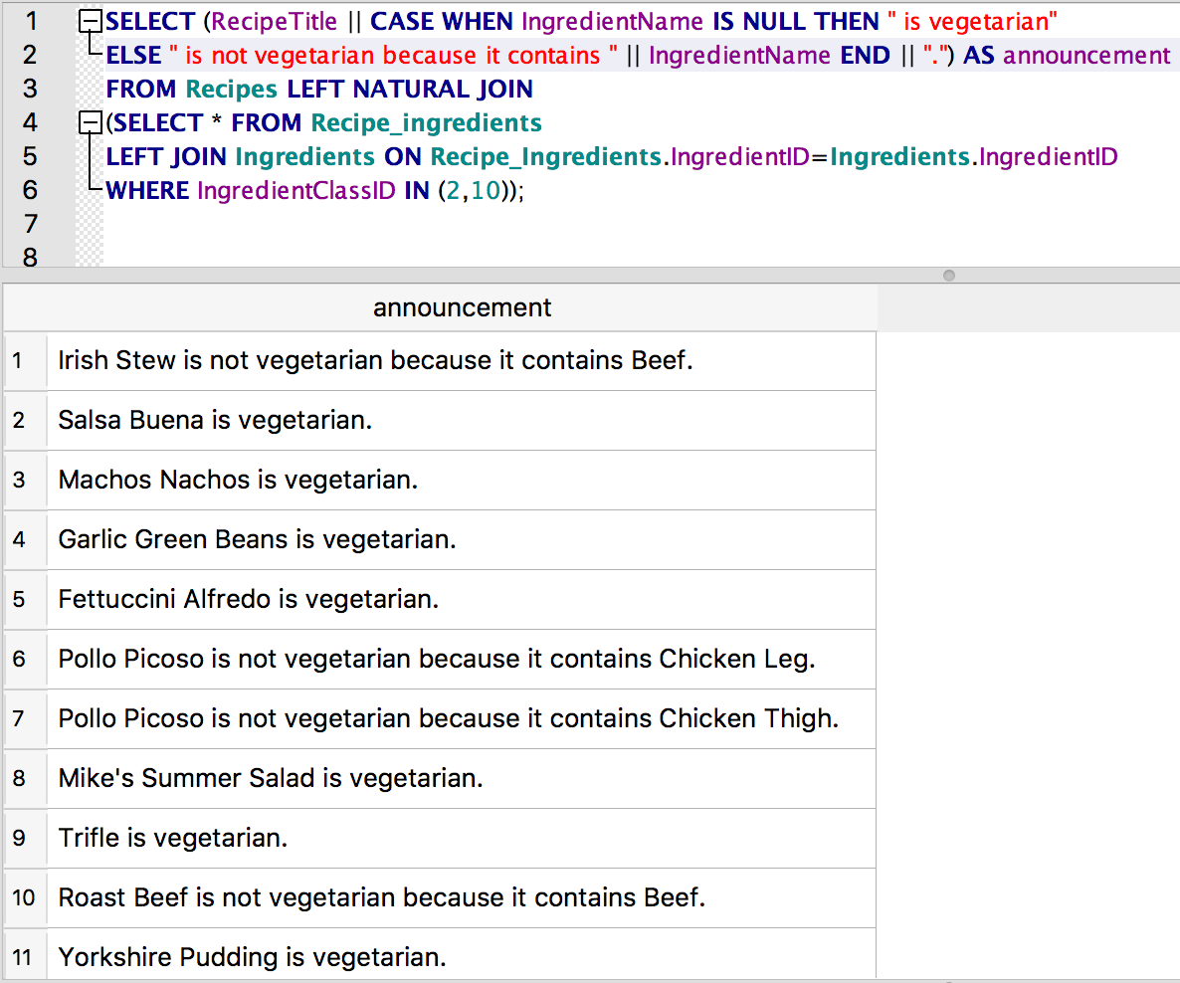
The result:
Could change the query to eliminate this duplication.

Slide 17
Recipes: Print every pair of recipes and the number of ingredients they share in common
SELECT r1.RecipeTitle, r2.RecipeTitle,
COUNT(i2.IngredientID) AS common_ingredients
FROM
Recipes AS r1 CROSS JOIN Recipes AS r2
JOIN Recipe_Ingredients AS i1 ON r1.RecipeID = i1.RecipeID
LEFT JOIN Recipe_Ingredients AS i2 ON
r2.RecipeID = i2.RecipeID AND i1.IngredientID=i2.IngredientID
GROUP BY r1.RecipeID, r2.RecipeID
HAVING r1.RecipeID < r2.RecipeID
ORDER BY common_ingredients DESC;

Slide 18
“Show me all ingredients and any recipes they’re used in” (108 rows)
SELECT IngredientName, RecipeTitle FROM Ingredients
LEFT JOIN Recipe_Ingredients
ON Ingredients.IngredientID=Recipe_Ingredients.IngredientID
LEFT NATURAL JOIN Recipes;

Slide 19
Recap
UNION, INTERSECT, and EXCEPT
Used to combine two SELECT statements.
Combines results table vertically (rather than horizontally for JOINs)
Necessary when answer requires two different (virtual) tables.
Discussed more advanced uses of predicates.
Summing an indicator variable.
Introduced CASE statement which chooses between two different options depending on some condition in the row.

