Slide 1
CS-310 Scalable Software Architectures Lecture 19: Distributed Computing
Steve Tarzia

Slide 2
Last time – Computing Platforms
Virtual Machines let multiple tenants share a single physical server.
Apps can be distributed as a VM disk image.
Containers create a consistent environment for your application.
Distribute as an image (like a VM disk image, but more lightweight),
Or as source code + a Dockerfile (a blueprint for the image).
Serverless functions are code that is staged in the cloud, ready to run:
They are automatically deployed and run on one or more VMs on demand.
Pros: • Gives more dynamic & fine-grained scalability than container/VM.
• Uses as many machines as needed, when needed. (zero to 1000s!)
Cons: • “Cold start” delay of several seconds (to copy code & launch).
• Function runtime is often limited (eg., 15 minutes for Lambda).

Slide 3
Easy vs. Hard scalability problems
Easy:
Handle independent requests from millions of customers.
Assume the data is already available to service the requests.
Trivially parallelizable – use horizontal scaling to divide and conquer.
Hard:
Perform a calculation using all the data from millions of customers.
Eg., build a recommendation system from Amazon order history.
Requires lots of coordination, housing data on the compute nodes.
Must use MapReduce, Spark, etc.
Luckily, it’s OK if the calculation takes several hours.

Slide 4
“Big Data” problems
Let’s say you need to run analyses of 10 petabytes of data each day:
1 Petabyte = 1024 Terabytes = 1024*1024 Gigabytes ≈ 10¹⁵ bytes
Theoretically, a single computer can do this in no less than:
10¹⁶ bytes / (80 * 10⁹ bytes/sec) = 125,00 seconds = 35 hours.
PCI express v4 max bandwidth
However, in practice you’ll find the performance is even slower than this.
To speed up an analysis you must use many machines to work on the problem in parallel.
The analysis is somehow split into pieces (subproblems)
Each machine works on subproblems that contribute to the final answer.
Subproblem results are redistributed to contribute to final solution.
Parallel data analysis is an active area of research in industry and academia.

Slide 5
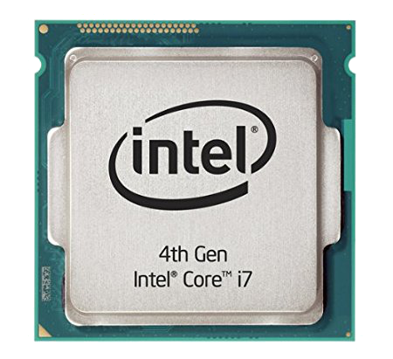
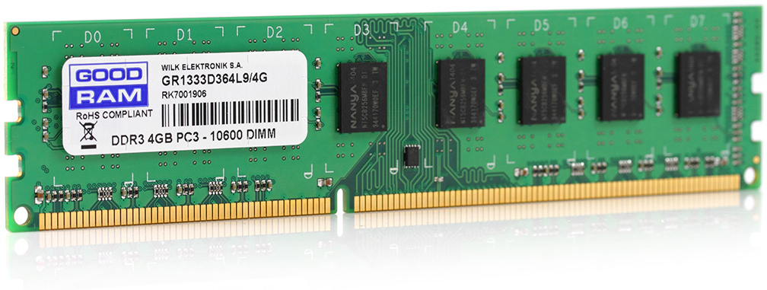
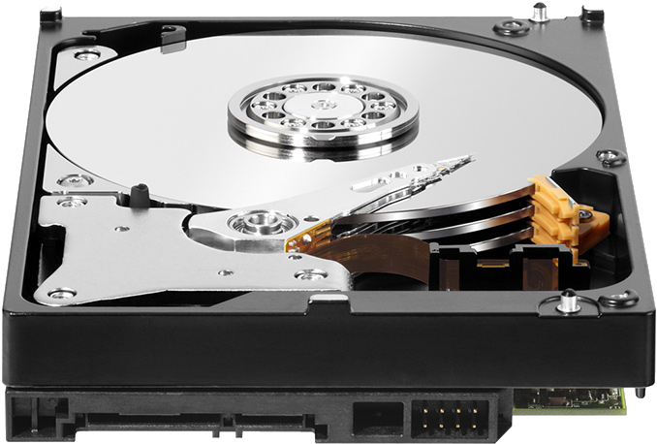
Distributed computing
Data & analysis are distributed across many machines.
No one machine has direct access to all the data.
Machines must communicate over a network to share data and intermediate results.
We need some special way to define these analyses.
Master
node
User program
Communication Network
Compute task
Compute task
Compute task
Compute task
Compute task
Compute task
Compute task
Data slice
Data slice
Data slice
Data slice
Data slice
Data slice
Data slice

Slide 6
Example: Find the largest sales order
Distribute instructions to all the machines (nodes).
Each node computes its own maximum.
Intermediate results are sent to a single node.
Maximum of the maximums is calculated.
Master
node
User program
Communication Network
User program
User program
User program
User program
User program
User program
Compute task
Jan. orders
Data slice
Feb. orders
Data slice
Mar. orders
Data slice
Apr. orders
Data slice
May orders
Data slice
Jun. orders
Data slice
Data slice

Slide 7
Example: Find the largest sales order
Distribute instructions to all the machines (nodes).
Each node computes its own maximum.
Intermediate results are sent to a single node.
Maximum of the maximums is calculated.
Master
node
Communication Network
Max= $32,344
Max= $54,321
Max= $10,302
Max= $31,204
Max= $4,291
Max= $33,201
Compute task
Jan. orders
Feb. orders
Mar. orders
Apr. orders
May orders
Jun. orders
Data slice

Slide 8
Example: Find the largest sales order
Distribute instructions to all the machines (nodes).
Each node computes its own maximum.
Intermediate results are sent to a single node.
Maximum of the maximums is calculated.
Master
node
Max= $32,344
Max= $31,204
Max= $54,321
Max= $10,302
Max= $4,291
Max= $33,201
Communication Network
Max= $32,344
Max= $54,321
Max= $10,302
Max= $31,204
Max= $4,291
Max= $33,201
Compute task
Jan. orders
Feb. orders
Mar. orders
Apr. orders
May orders
Jun. orders
Data slice

Slide 9
Example: Find the largest sales order
Distribute instructions to all the machines (nodes).
Each node computes its own maximum.
Intermediate results are sent to a single node.
Maximum of the maximums is calculated.
Max of monthly maxes = $54,321
Communication Network
Max= $32,344
Max= $54,321
Max= $10,302
Max= $31,204
Max= $4,291
Max= $33,201
Compute task
Jan. orders
Feb. orders
Mar. orders
Apr. orders
May orders
Jun. orders
Data slice

Slide 10
Maximum aggregator is trivially parallelizable
Most of the work can be done with no coordination.
Very little communication is required.
What other calculations are easy to parallelize?
Sum, min, max, mean, search/grep, etc.
How would you parallelize median calculation if data is distributed?
Hint: first look up the basic (sequential) quickselect algorithm.
Can be parallelized by sharing pivot value and size of subset set ≤ pivot.
One node (leader) chooses a pivot, shares with all other nodes.
Each node rearranges its data into two sets: L (≤ pivot) and R (> pivot).
Nodes send (|L|) to the leader. Leader chooses a new pivot either greater or less than the previous pivot, depending on whether on sum(|L|) < n/2.
Repeat on subset L or R (as appropriate) until sum(|L|) == n/2
STOP and THINK

Slide 11
Basic features of distributed computing
Input data is split among many nodes.
Code must be distributed to many connected nodes.
Many rounds of communication may be needed for an algorithm.
A distributed algorithm can be written from scratch in any language by:
reading/writing memory and files, and
making network connections to other nodes to communicate.
However, distributed computing frameworks have been developed to manage the common tasks required by all big data analyses.
Eg.: MapReduce/Hadoop, Dryad, Spark, MPI, OpenMP.
Computing frameworks require you to follow their own patterns, but by doing so you gain many powerful features (analogous to using a DB for storage).

Slide 12
Hadoop is a distributed computing platform
It’s a type of computing cluster for storing data and running analyses.
Main components are:
HDFS – Hadoop Distributed File System for storing the data to be analyzed and also for storing intermediate and final results.
Data is distributed across all the nodes (machines) in the cluster.
HDFS is closely coupled to the analysis engine.
Moving/querying the data would be too slow, so we run analysis on the storage cluster.
MapReduce – a programming model for defining the parallel analysis steps.
Analysis is usually written in Java, but other languages are possible (Python, R, etc.)
Analysis is defined in terms of two main operations – Map and Reduce.
Based on a 2004 Google article: https://research.google/pubs/pub62/

Slide 13
MapReduce
MapReduce is a framework for parallel processing imposing a certain pattern:
First, Map does something, producing many intermediate results.
Later, Reduce aggregates the intermediate results.
The framework handles the distribution of intermediate results, job scheduling, etc. Programmer just implements Map and Reduce.
Key-value pairs
Input
Output
Map tasks
Reduce tasks

Slide 14
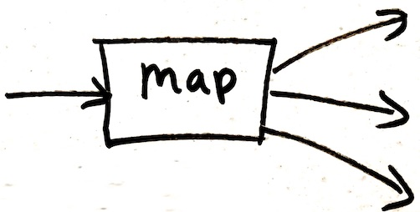
MapReduce programming model
Input & Output: each a set of key/value pairs
Programmer’s task is to define just two functions that will complete the work in parallel:
map(in_key, in_value) -> List(⟨out_key, intermediate_value ⟩)
Processes input key/value pair
Usually key=filename, value=line of text
Produces a set of intermediate pairs
reduce(out_key, Iterator(intermediate_value)) -> list(out_value)
Combines all intermediate values for a particular key
Produces a set of merged output values (usually just one)

Slide 15
MapReduce example: frequency of words
map(String input_key, String input_value):
// input_key: document name
// input_value: document contents
for each word w in input_value:
return List(⟨w, 1⟩);
reduce(String output_key, Iterator intermediate_values):
// output_key: a word
// output_values: a list of counts
int result = 0;
for each v in intermediate_values:
result += v;
return List(result); // implicitly, output_key is also part of the output.

Slide 16
Counting words example
reduce(String output_key, Iterator intermediate_values):
// output_key: a word
// output_values: a list of counts
int result = 0;
for each v in intermediate_values:
result += v;
return result;
map(String input_key, String input_value):
// input_key: document name
// input_value: document contents
for each word w in input_value:
return (w, "1");
Reduce Output
Map Output
Splitting and shuffling steps are done automatically by the Hadoop runtime system

Slide 17
Communication between many nodes
The inter-node communication is handled entirely by:
The shuffle step, and
The distributed file system splitting the data across the compute nodes.
The input files stored on each node will be assigned to that node's mapper. This drastically reduces communication overhead.
The user code does not do any explicit communication.

Slide 18
The Hadoop framework provides:
The Hadoop Distributed File System (HDFS) for distributing input and output data among many nodes.
Input to a program is usually a folder with files distributed on many nodes.
Again, the output of the program is a series of files written to a folder.
A runtime system to manage job scheduling and coordination:
Many copies of your program are made (forked) and run on many nodes.
One node is set to be the “master.” It assigns work (input data) to workers.
Workers (mappers and reducers) write results to HDFS and notify the master.
A scalable, distributed sorting algorithm for the “shuffling” step.
All the intermediate data (produced by the mappers) must be sorted by the key so all data for a single key can be sent to one reducer.

Slide 19
To see lots of examples of MapReduce programs:
https://research.google/pubs/pub62/
MapReduce tips:
You can chain multiple MapReduces: (map1, reduce1, map2, reduce2)
For complex problems, think about specifying a series of intermediate results.

Slide 20
Spark improves on MapReduce/Hadoop ideas
Spark is very similar to Hadoop/MapReduce, but it solves some performance issues and its programs are easier to write and read.
Hadoop is slowed by using the filesystem too much.
Recall that disk latency is 10M× greater than memory.
Every Hadoop step uses the disk; it stores all of the following on disk:
Inputs to Map.
Intermediate values output by Map.
Reduce results.
Why? Writing to disk simplifies data sharing and fault tolerance.
Many iterations of MapReduce may be needed to solve a task (eg., PageRank). This is messy to write and involves a lot of disk activity.

Slide 21
Spark innovations
User writes a driver program which can have an arbitrary number of steps. Analysis can also be run interactively for data exploration.
More parallel operations are available (not just Map and Reduce):
flatMap (like Hadoop map), map (one to one), filter (return a subset).
reduceByKey (like Hadoop reduce), reduce (to one node).
forEach (process Scala collection items in parallel), collect (send all elements back to the driver node)
Operations to improve performance:
A cache operation to keep a data set in memory between parallel tasks.
accumulators with results only visible to the driver.
Allows parallel processing without HDFS.

Slide 22
Resilient Distributed Datasets (RDDs)
The most important innovation of Spark is to represent intermediate values as reproducible objects instead of saving to disk.
RDDs are either:
A filename referring to something stored in HDFS.
A reference to an in-memory collection (eg., List) in the driver program.
The result of a parallel transformation of another RDD (eg., map, filter).
A save or cache action applied to an RDD. This does not change the data.
An intermediate result might be represented as:
myList[400:500].map(i -> sqrt(i)) //myList is in driver memory
textFile("data0032.txt").map(line -> line.split(" ")).filter(w -> w=="Steve")
If node processing either of the data above crashes, the in-memory copy is lost ☹
However, it can be re-generated from the lines above by re-running the fraction of the analysis that led to that data. ☺
Data is ephemeral (in memory-only) but data provenance is safeguarded.
If the driver program crashes the analysis will fail anyway.

Slide 23
Spark example: Text Search
val file = spark.textFile("hdfs://...")
val errs = file.filter(_.contains("ERROR"))
val ones = errs.map(_ => 1)
val count = ones.reduce(_+_)
The first three lines all define new RDDs.
errs and ones are can be lazy-evaluated: for efficiency, don't run the filter and map until we know the final destination of the data.

Slide 24
Example: Logistic Regression (ML classification)
Find a hyperplane w that best separates two sets of points.
Solve with gradient descent.
cache operation keeps points in memory through many iterations.
Each training point contributes to gradient in parallel through accumulator.
// Read points from a text file and cache them
val points = spark.textFile(...)
.map(parsePoint).cache()
// Initialize w to random D-dimensional vector
var w = Vector.random(D)
// Run multiple iterations to update w
for (i <- 1 to ITERATIONS) {
val grad = spark.accumulator(new Vector(D))
points.foreach(p -> { // Runs in parallel
val s = (1/(1+exp(-p.y*(w dot p.x)))-1)*p.y
grad += s * p.x
})
w -= grad.value
}

Slide 25
Traditional Parallel Computing
Scientists have done large parallel computations starting decades before “big data” trends and the Internet.
However, the tools they use are very different.
Use clusters of machines with special low-latency networking.
Called “Supercomputing” or “High Performance Computing” (HPC).
Data is stored on different nodes than where computing is done.
Programming is done in C or Fortran.
Parallelization is done with:
OpenMP – to automatically parallelize loops, etc.
MPI – programmer uses gather, scatter, etc., to distribute intermediates.
Fault tolerance is a major problem in large supercomputing application because they can have ~100,000 machines (~10M cores).

Slide 26
Recap
To efficiently analyze large data sets, it's important to merge computation and storage on the same machines. Minimize transfers.
Hadoop is an open-source implementation of MapReduce.
A framework for parallel computing on Big Data problems.
Requires programmer to somehow express analysis as Maps and Reduces.
HDFS distributes input and output data files on the compute nodes.
Spark improves performance by storing intermediate results in memory.
Resilient Distributed Datasets enable this.
Syntax is richer, leading to code that is easier to write and read. Multiple steps can be expressed easily.
It's easier for beginners to get started. Need not store inputs in HDFS.

Slide 27
Architectural concepts in this class:
Computing Platforms:
Virtual Machines
Containers.
Serverless functions.
Programming Models:
Stateless (micro)services.
MapReduce/Spark.
Network-level optimization:
HTTP caches.
CDNs (Content Delivery Networks).
Coordination:
Load balancers.
REST APIs.
Distributed Message Queues.
Push Notifications, WebSockets.
Data storage:
SQL Relational DBs.
NoSQL DBs.
Distributed file systems.
Browser cookies, auth tokens.

Slide 28
Class Recap
The Goal: to learn enough to build your own scalable startup product. Bypass the “on the job training” or self-study usually required.
To Explore this Further:
CS-345 Distributed Systems
Shared-nothing distributed systems, consistency (NoSQL databases)
CS-340 Intro to Computer Networking
Application layer protocols (HTTP, REST APIs)
CS-343 Operating Systems
Processes and threads
Performance of storage vs RAM
CS-339 Intro to Databases
Mostly covers relational database internals.

