Slide 1
CS-310 Scalable Software Architectures Lecture 3: Stateless Services, Proxies, and Caches
1
Steve Tarzia

Slide 2
Last time:
2
Showed that web server frameworks let you translate a simple program into a multi-threaded service with concurrency.
Introduced HTTP as the most common type of service.
Client requests a document (specified in path/url)
Server sends document in the response.
High-level overview of Wikipedia’s architecture.
Showed examples of traditional dynamic web code, where HTML is programmatically generated.

Slide 3
Are all workers equal?
3
Each request can be handled by one of several possible “worker” threads.
Does it matter which is chosen?
It depends on how the app code is written!
STOP and THINK

Slide 4
Stateless and Stateful worker threads
4
state == memory
A stateless thread/process/service remembers nothing from past requests.
Behavior is determined entirely by two things: 〈input request, request handling code〉.
Different copies of the service are running the same code, so they will give the exact same response for a given request.
Has no local state.
A stateful thread (or service) changes over time, as a side effect of handling requests.
Persistent, global variables are modified by the request processing code.
We’ll see later that state is pushed up to client or down to a database.

Slide 5
Stateless code has no long-term “memory”
5
It’s almost a “pure function” in programming language terminology.
Output is not affected by previous inputs.
We do not say “output is determined entirely by the current input,” because we allow nondeterministic (random) behavior.
Eg:
float cosine(float x)
int sum(int a, int b)
List sort(List myList)
List<T> listAppend(List<T> myList, T newItem)
float generateRandomNumber()
Real random number generators actually do keep some state, but ideally they would not.

Slide 6
Stateful code has side effects (long-term memory)
6
It’s like an object or a code that changes global variables.
Object-oriented mutator:
Class Counter {
private int count;
public Counter() {
count = 0;
}
public void increment() {
count++;
}
}
Imperative code changing globals:
int count;
void increment() {
count++;
}

Slide 7
Side note on OOP
What are the main purposes of object-oriented programming?
You probably learned:
Inheritance:
This allows strong typing without losing abstraction.
Creates generic, abstract interfaces, enabling abstraction.
Modeling real-world concepts.
Animal → Mammal → Cow!)
But another major OOP benefit is:
Grouping sets of related state (memory/variables).
Well-defined, limited side effects.
A class defines a set of member functions whose side-effects are limited to a small set of variables (the object’s data members).
STOP and THINK

Slide 8
Horizontally scaling Stateful vs Stateless code
Let’s say we want to run many copies of our service code in parallel to handle lots of requests (horizontal scaling).
Stateless code (has “no memory”):
All copies will give same response, it does not matter which copy processes a given request.
Parallelism is trivially easy!
Stateful code (does have “memory”):
Since different copies handled different past requests, their state differs, and they may give a different response to the exact same request.
Related requests (from the same client) must go to same handler.

Slide 9
Stateful example: SMTP
C: means client request
S: means server response
C: HELO relay.example.com
S: 250 smtp.example.com, I am glad to meet you
C: MAIL FROM:<bob@example.com>
S: 250 Ok
C: RCPT TO:<alice@example.com>
S: 250 Ok
C: RCPT TO:<theboss@example.com>
S: 250 Ok
C: DATA
S: 354 End data with <CR><LF>.<CR><LF>
C: From: "Bob Example" bob@example.com C: To: Alice Example alice@example.com C: Cc: theboss@example.com C: Date: Tue, 15 January 2008 16:02:43 -0500 C: Subject: Test message C: C: Hello Alice. C: This is a test message with 5 header fields C: and five lines in the message body. C: Your friend, C: Bob C: .
S: 250 Ok: queued as 12345
The text at right shows a series of 6 requests and responses sent from an email client to an email server.
The result is a single new email.
Server must remember information from the previous requests to finally build the email message.
If we were running the email server code in parallel on many machines, then all these requests must be handled by the same server to complete the task.

Slide 10
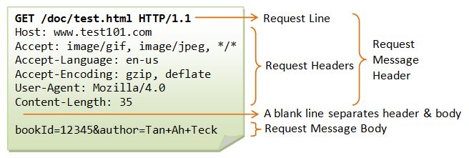
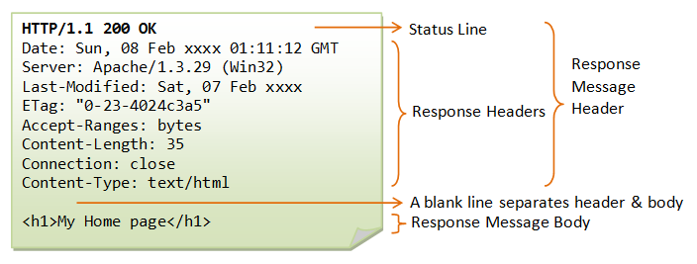
Stateless example: HTTP
Request:
One big request that is self-sufficient (independent)
(optional for GET)
Response:
From https://www.ntu.edu.sg/home/ehchua/programming/webprogramming/HTTP_Basics.html

Slide 11
Should MediaWiki (Wikipedia) be stateful or stateless?
11
Tasks:
Get corresponding wiki text from DB.
Translate wiki text to HTML.
Add wrapping content and banners.
Add user-specific page header, based on cookies in request.
Recall:
Stateless applications do not remember anything from previous requests.
Each request can be handled independently based exclusively on the input request.
Can be trivially parallelized because handling a request has no side effects in the handler.
Which of these tasks have side effects?
Are there other MediaWiki tasks that have side effect?
STOP and THINK

Slide 12
Page Edit might have side effects in MediaWiki
12
Most visitors just read Wikipedia pages, but some also edit pages.
Edits are sent as HTTP POST requests to the same MediaWiki app.
Clearly, these edits should affect the results of future page fetches.
If I edit a page on server A, then a user requesting the same page from server A or server B should see my edits.
The edits should have system-wide side effects.
Can MediaWiki still be stateless?
Yes! Databases separate system state from stateless request handlers.
The edit’s results are stored by MediaWiki in an external, shared DB.
The DB must be queried for every page fetch.
Thus the PHP code in MediaWiki can remain stateless and easily parallelized.
STOP and THINK
Push state down to a database.

Slide 13
Sign In might have side effects in MediaWiki
13
After signing in, all later response HTML will have a different page header, including your username, notifications, etc.
Handling a “sign in” request has a side effect on later page fetches.
How can we avoid keeping this “sign in” state in MediaWiki?
Cookies solve this problem
Sign-in leads to a cookie being stored in the DB and returned to the client browser. So, client and DB keep the sign-in state.
Client sends the cookie as an HTTP header in all future requests.
Cookie is provided as an input to MediaWiki, and MediaWiki checks the cookie against cookies stored in the shared database.
Even better, signed cookies can be verified without a backend database.
STOP and THINK
Push state up to the client

Slide 14
Response to sign-in request gives user a cookie
Cookies are how web applications track state, often to track user identity.
If username and password were correct, server will return a cookie in the response:
Response tells the browser to redirect to http://somewebsite.com/account, but it also gives the browser a cookie to remember.
Browser will include the cookie in all future HTTP requests to somewebsite.com:
Server getting this request can use the cookie to determine which user it came from!
HTTP/1.1 302 Found
Location: http://somewebsite.com/account
Set-Cookie: someweb-id=kfj203d14t9s
GET /account HTTP/1.1
Host: somewebsite.com
Referer: http://somewebsite.com/bin/login
Cookie: someweb-id=kfj203d14t9s
…
Is HTTP with cookies still stateless?
STOP and THINK

Slide 15
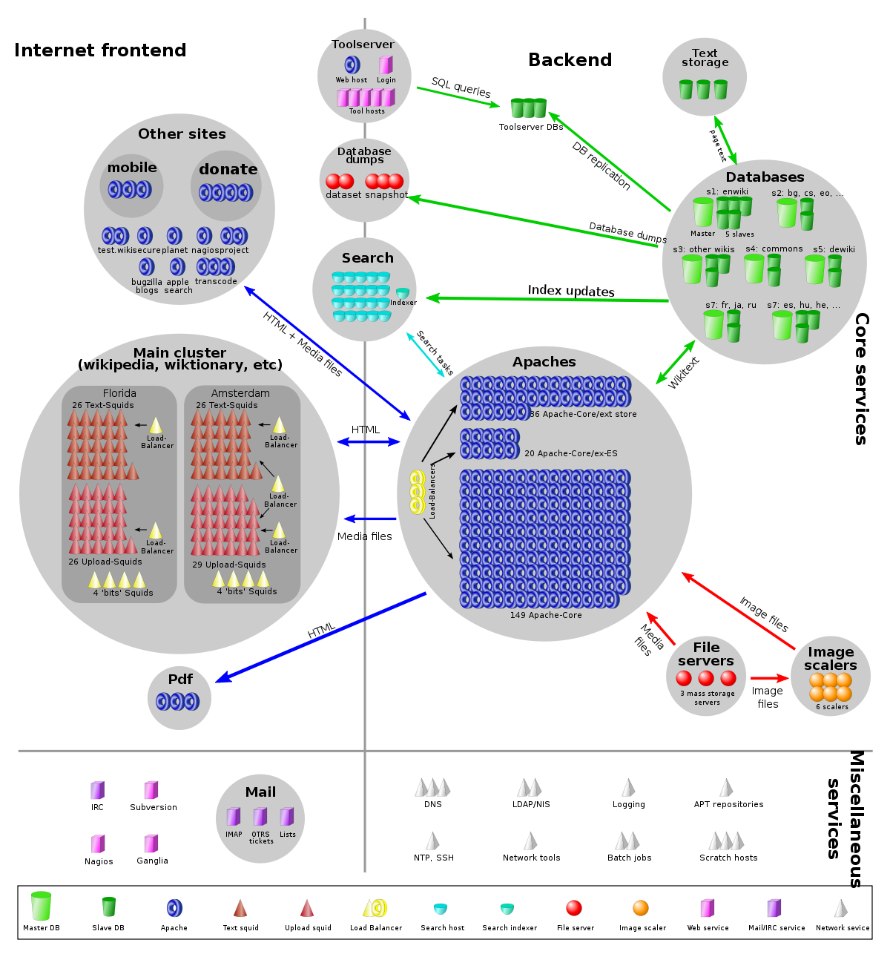
How does statelessness help?
15
200 instances of MediaWiki can be run behind a load balancer.
Load balancing is done both by DNS and by efficient, simple software proxies.
Any of the 200 instances can handle any request.
Each of those 200 machines also has many CPU cores and dozens of software threads.
Coordination only happens by writing to shared databases.
MediaWiki

Slide 16
Design Example: A chess website
We need to track the state of many games being played at once.
We want to render pages like this: https://chess.com/game/23
Simplest design is to store game state in memory (eg., in a dictionary)
How can we scale this app?
Vertically?
Horizontally?
User1
User2
User3
User4
User5
User6
GET /game/1
chess.com WebApp
STOP and THINK
One
Machine

Slide 17
Horizontal scaling of chess app
Our first attempt will run the same simple code on multiple servers.
Each game runs on one of many servers. Each server handles a fraction of games.
Can you see any problems with this scaling approach?
User must connect to exact same server to continue their game. How to direct user?
If a server fails, 1/n games are lost (or at least interrupted).
These are stateful web apps.
User1
User2
User3
User4
User5
User6
User1
User2
User3
User4
User5
User6
User1
User2
User3
User4
User5
User6
STOP and THINK
chess.com WebApp
chess.com WebApp
chess.com WebApp
Notes:
Also, there is no way to handle lots of spectators on a single popular/celebrity game without overwhelming the host server.

Slide 18
Stateless design of horizontally-scaled chess app
STOP and THINK
Push all the game state to a central, shared database.
This is equivalent to MediaWiki pushing all article data to a DB.
User can connect to any one of the chess webapp instances to play any game.
Some kind of load balancer directs user to a server instance (more on this in later lectures).
Any problems with this approach?
The DB is a central, shared resource that will limit scalability.
User1
User2
User3
User4
User5
User6
User1
User2
User3
User4
User5
User6
User1
User2
User3
User4
User5
User6
"load balancer" connects users to any app instance
chess.com WebApp
chess.com WebApp
chess.com WebApp
Game Database
STOP and THINK

Slide 19
Review
19
Defined stateless and stateful services.
Showed how databases and cookies make MediaWiki stateless and scalable.
In other words, we achieved parallelism and distributed execution while avoiding difficult coordination problems. Just push away all shared state. Push state up to client and/or down to database.
First lesson of scalability: Don’t share!
Unsolved problems:
How to direct users to an instance of a service (load balancing)?
How to avoid a performance bottleneck in the database?

